Slide 1
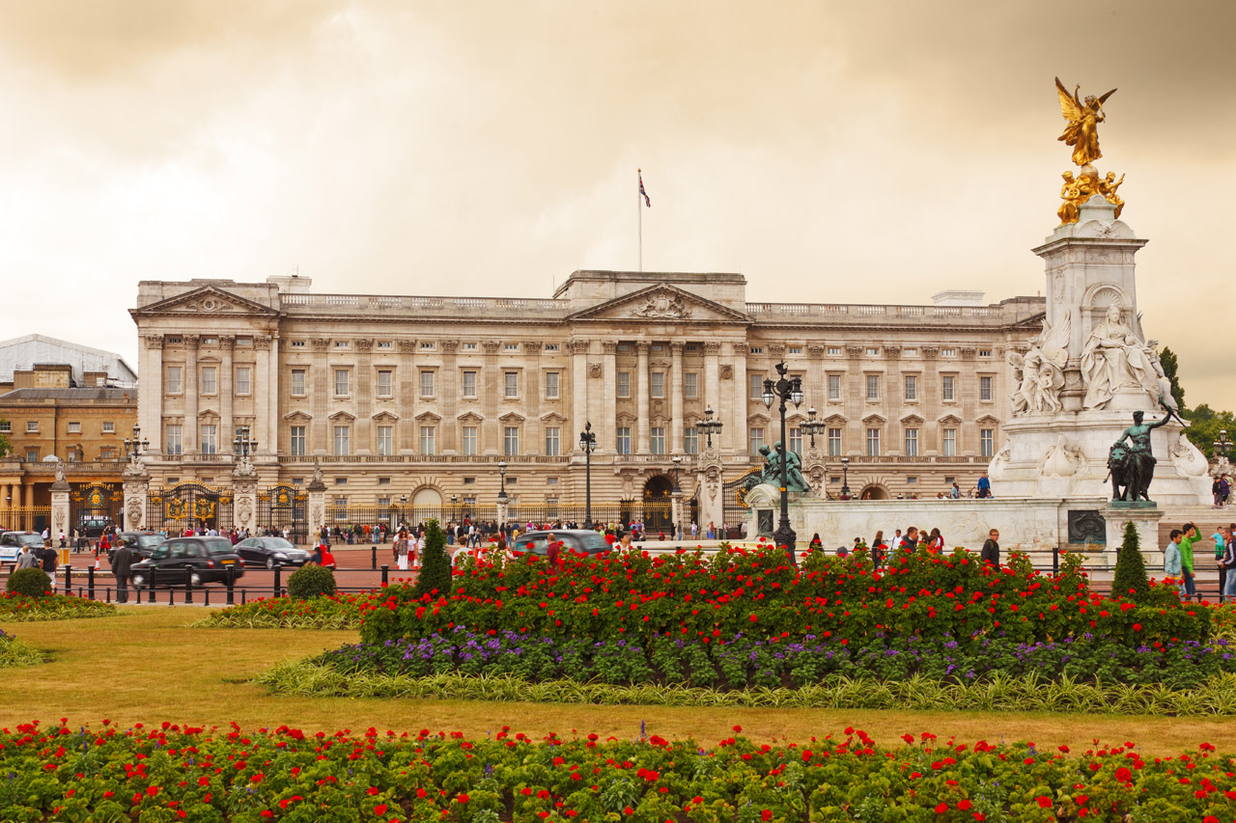
Buckingham Palace

Slide 2
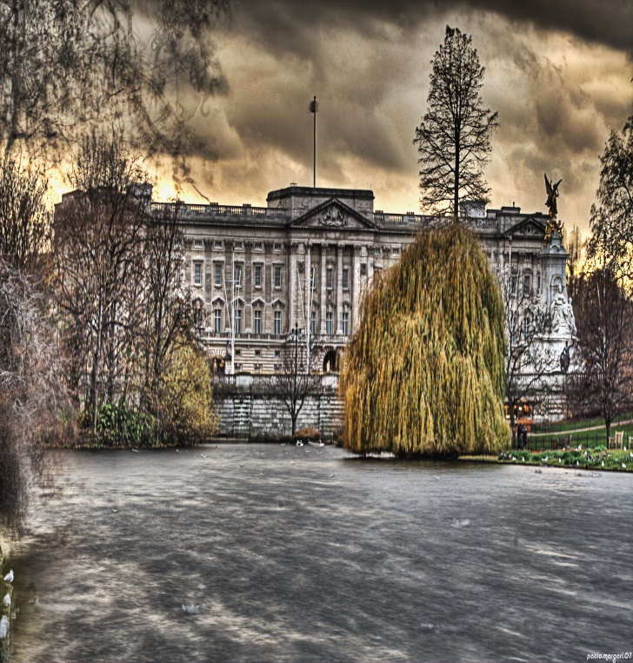
Buckingham Palace
The palace in history
Built in 1703 for the Duke of Buckingham , the building was acquired by King George III in 1762 for use as a private residence. Since its construction it has been expanded and remodeled several times.
During the two world wars the palace survived in an exemplary manner. In the First World War it was lucky not to be attacked but, during the Second World War, it was bombed on different occasions . The most important bombing destroyed the royal chapel in 1940.

Slide 3
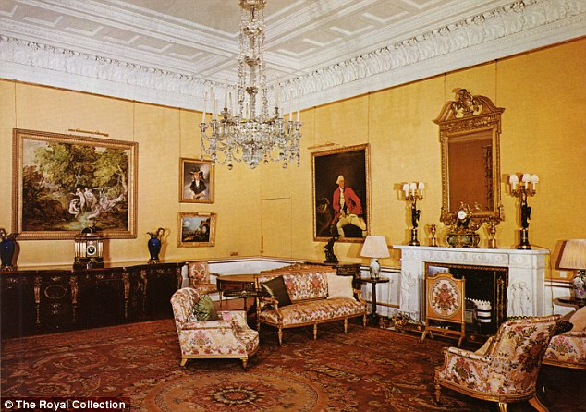
rooms
There are more than 700 rooms in the palace.
Buckingham Palace has welcomed thousands of visitors over the years. And with a whopping 775 rooms, they have it very easy. This number includes 52 royal and guest rooms, 188 staff rooms, 19 staterooms and 78 bathrooms.
In total, it can be said that there is more than enough space for the Royal Family and all their friends. Imagine the pajama parties that could be held.

Slide 4
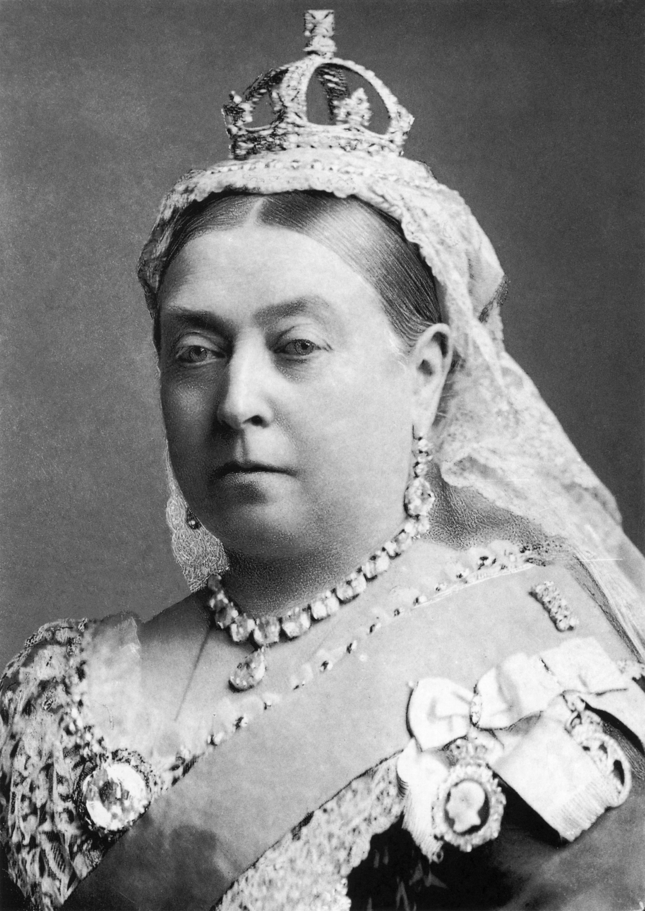
Queen Victoria was the first British sovereign to live in Buckingham Palace
Buckingham Palace was built on the orders of King George IV at the end of the 18th century, although its history goes back much further. In fact, it dates back to the Middle Ages, when the place was part of the manor of Ebury. We had not heard of this manor either.
The site was used for different buildings by different people, including Henry VIII in the 16th century. However, once the works planned by King George IV were completed, he never had the opportunity to call it home.
Its first official resident was Queen Victoria, who settled there a few years later, in 1837. It was then that the palace became the official royal residence. Since then, many monarchs have come and gone. It was the main residence of the late Queen Elizabeth II, and is currently being renovated, so for now Charles III will not live there.

Slide 5
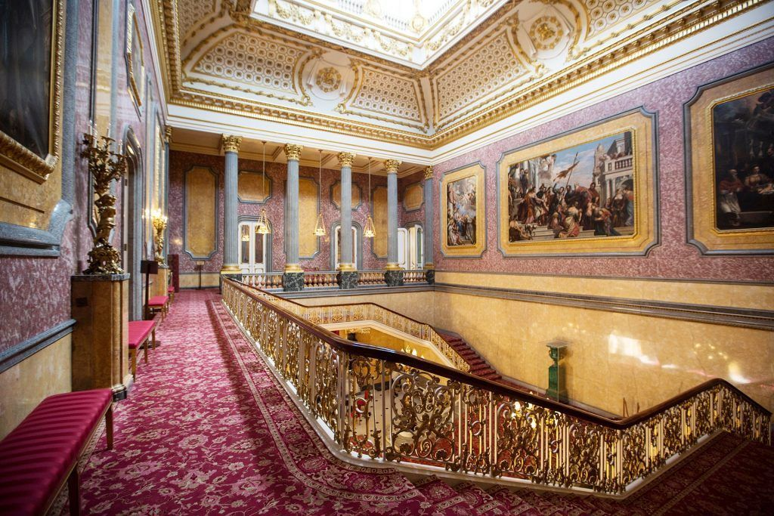
The palace was over budget, but by far
steemed architect John Nash transformed the original Buckingham House into the lavish palace it is today. However, he accidentally went over budget. If you look at the gold “details”, you'll get an idea why.
Finally they fired him in a bad way. But without his mistake, we wouldn't have the palace we all know and love today. So really Nash should be forgiven.

Slide 6
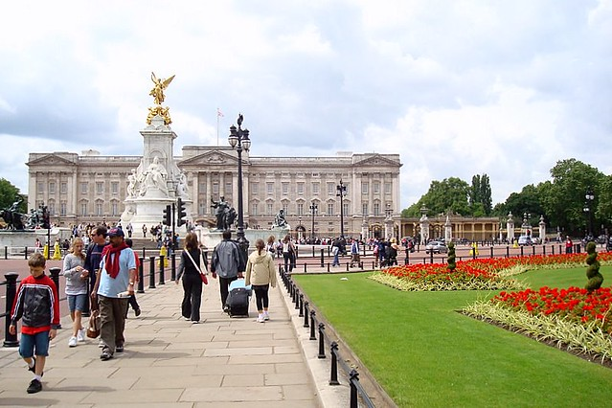
Is a must-see for anyone visiting London in the summer, when the state rooms open to the public.
Maybe you're a big fan of the royal family or you just want to see one of Britain's greatest symbols. It doesn't matter. You are sure to find something that fascinates you in its sumptuous and historic interiors. And if your trip is in winter, you can always come and see it from the outside.
The palace has a long and colorful history. I wouldn't be British without her. So, without further ado, here are some fascinating facts about Buckingham Palace that you may not know.

