Slide 1

O'FARRIL SCHOOL
Primary Section - Group 4th "B"
Work submitted in partial compliance with the requirements for English class
By:
Silvana Espinosa Elguea
Mexico City,November 5 2023
“THE BIG BEN”

Slide 2
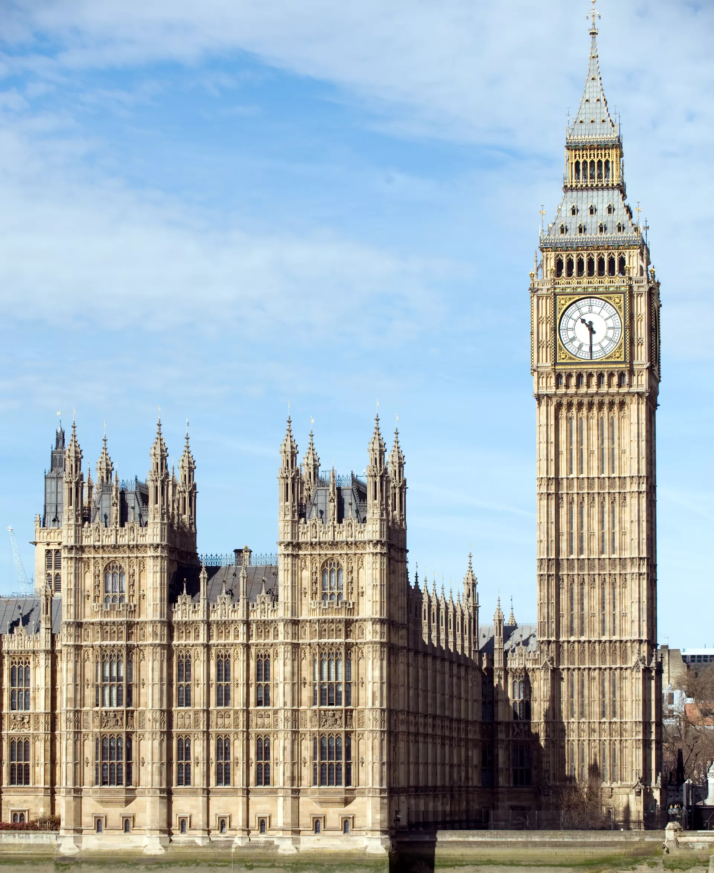
The History
The tower was officially called the Clock Tower until 2012, when it was renamed to mark the Diamond Jubilee of Elizabeth II
The Design
The tower was designed by Augustus Pugin and was completed in 1859.
It is elaborately decorated and includes symbols related to the four nations of the United Kingdom

Slide 3

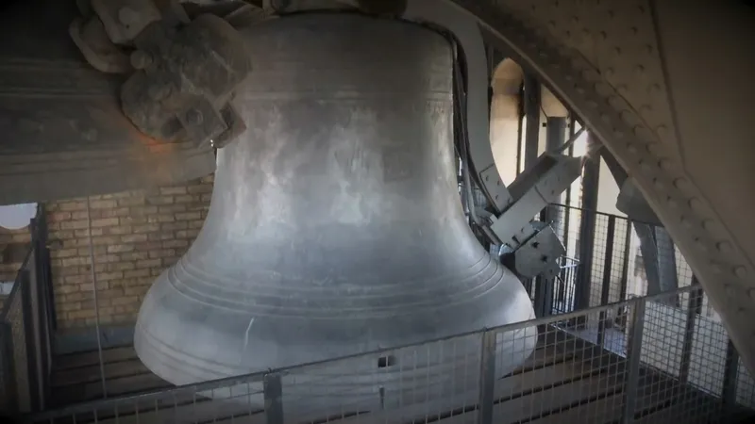
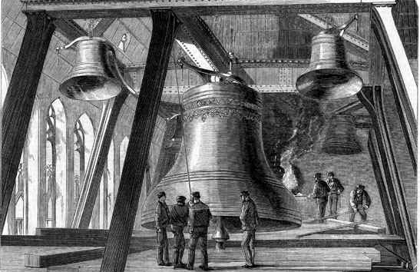
The Bell
The main bell, officially known as the 'Great Bell' but better known as Big Ben, is the largest bell in the tower and part of the Great Clock of Westminster.

Slide 4
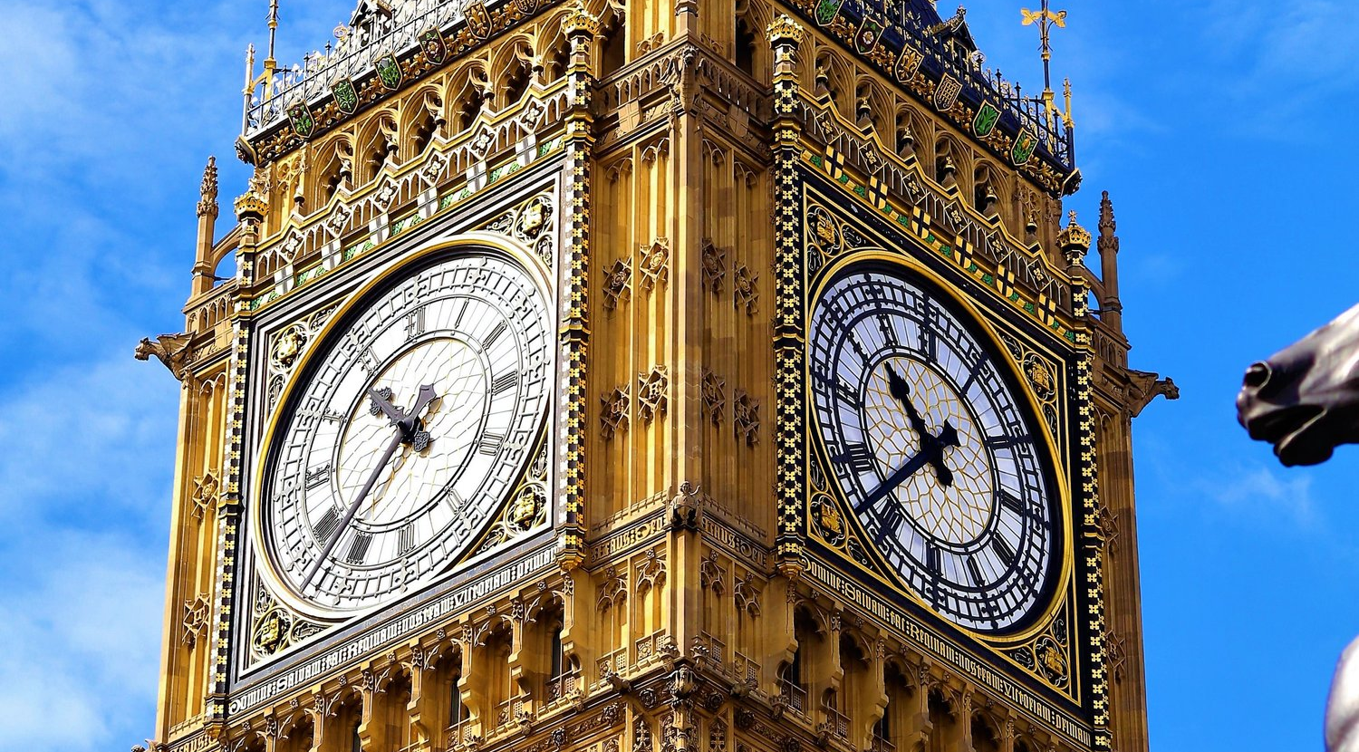
The Clock
Has become a cultural symbol of the United Kingdom, particularly in the visual media. When a television or film-maker wishes to indicate a generic location in the country, a popular way to do so is to show an image of the tower, often with a red double-decker bus or black cab in the foreground

Slide 5
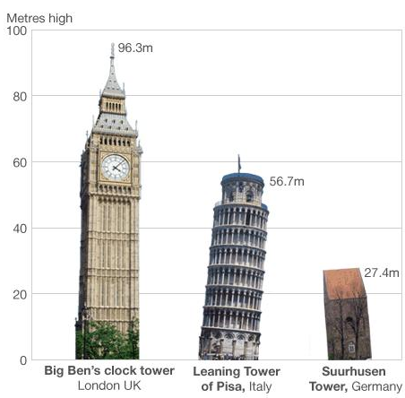
More Data
Country:
United Kingdom
Location:
London
Construction:
September 28, 1843
Completion:
May 31, 1859
Height:
96.2m

