Slide 1
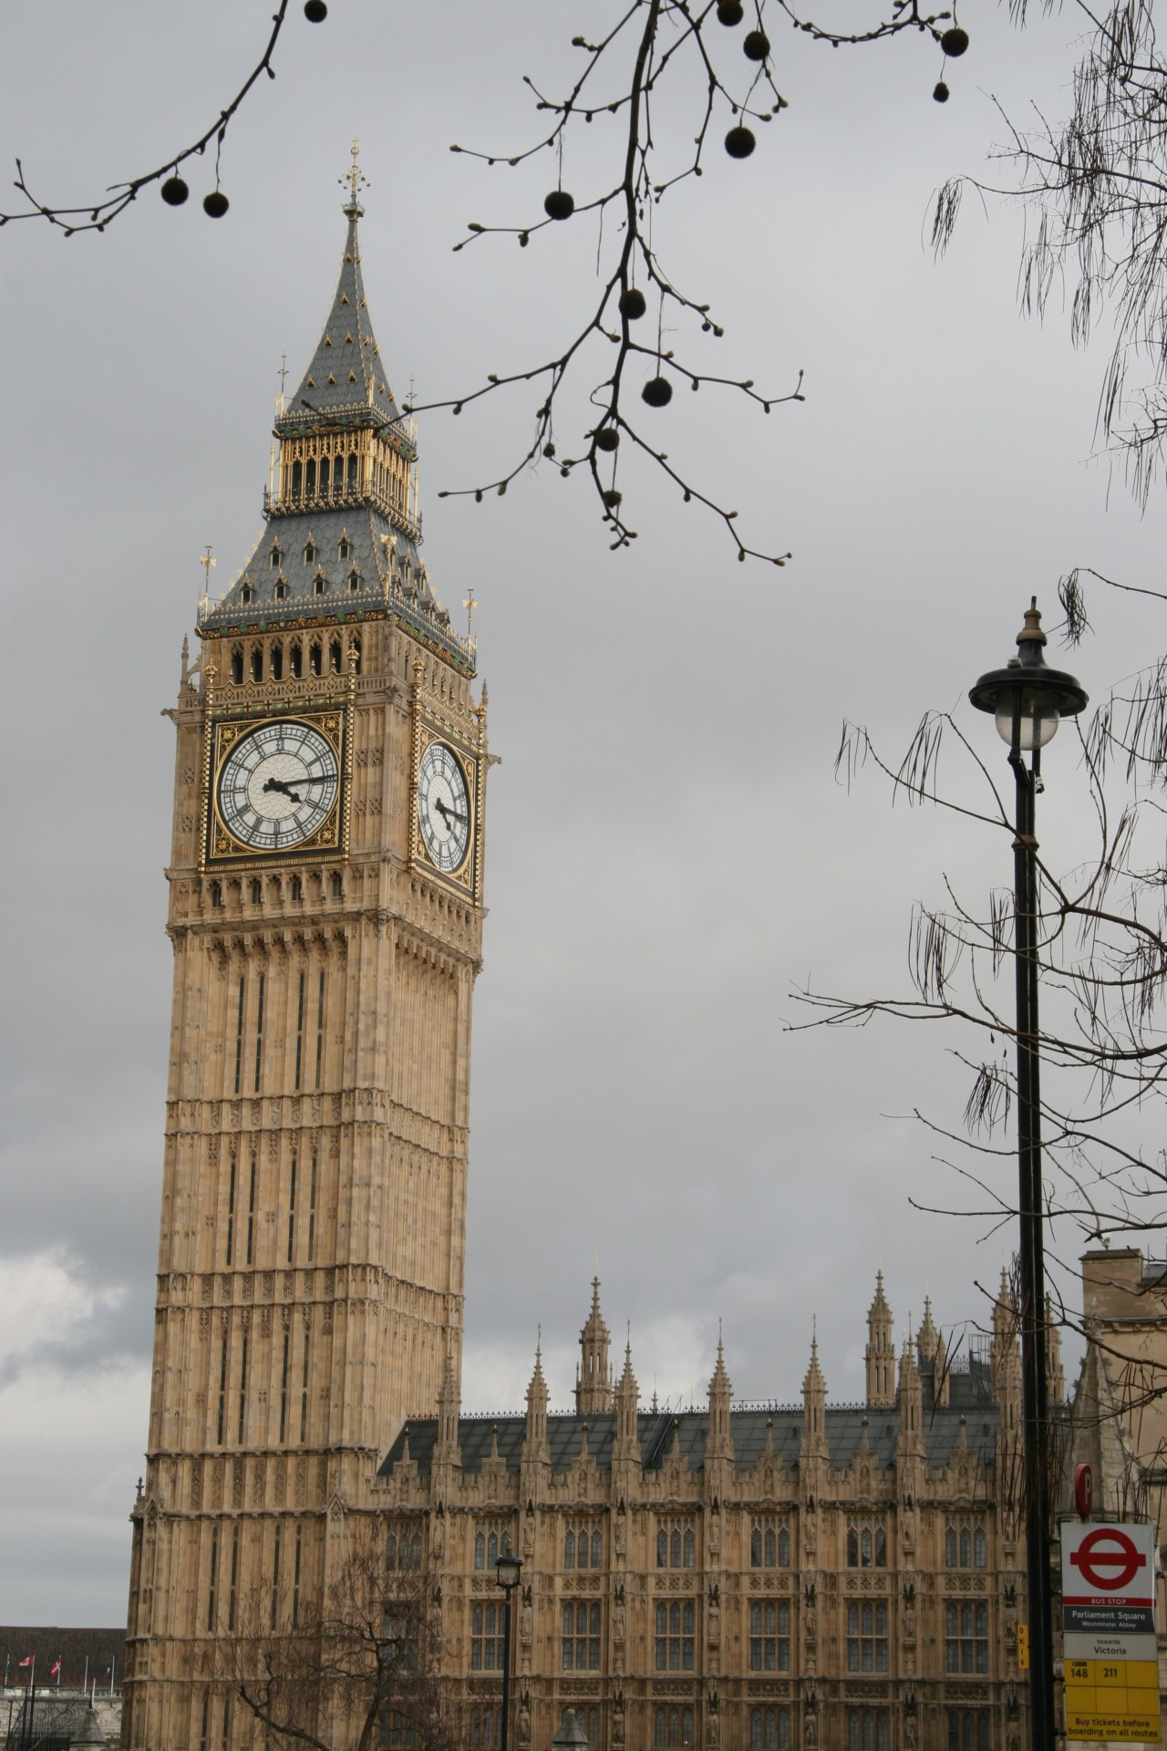
The big ben
Frida Antonela Rojas Paz

Slide 2
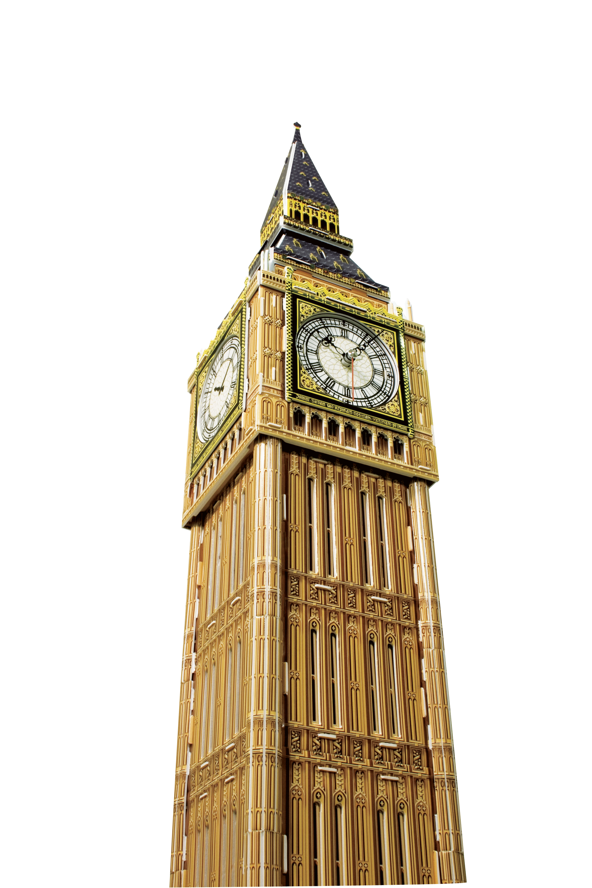
The big ben is the most representative tower in the city of London and is home to one of the largest mechanical clocks in the world. Big ben is the name by which the tower is known worldwide, but it is worth mentioning that since 2012 its real name is Elizabeth tower

Slide 3
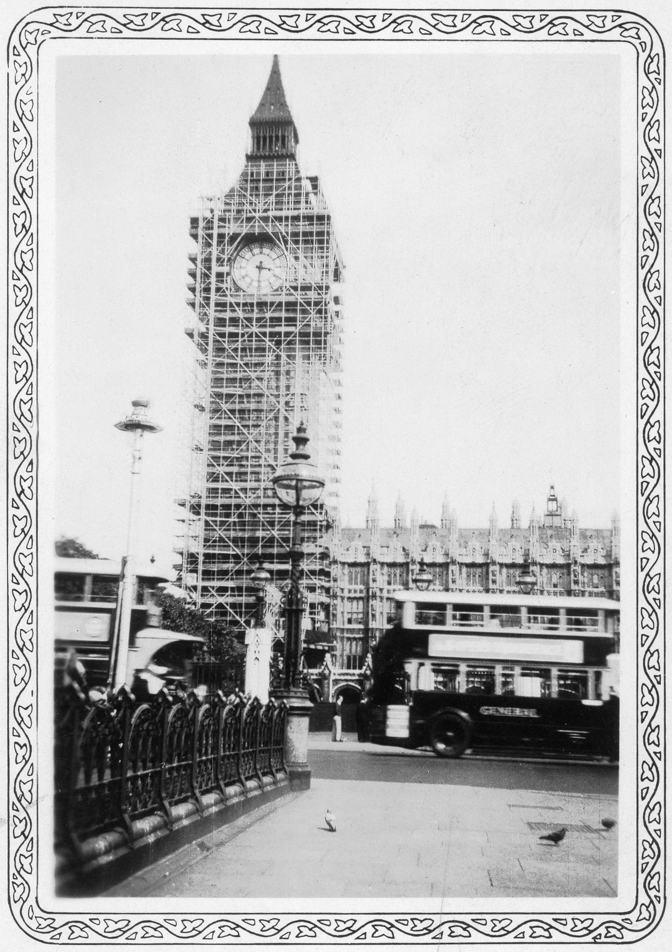
The construction of Big Ben began on September 28, 1843 when the fundation stone of Big Ben was laid.This monument has weighs about 13.8 tons, has a height of 96.3 meters and sits on a base of 225 square meters. This clock is reliability as it has rarely stopped working.
Esta foto de Autor desconocido está bajo licencia CC BY-SA

Slide 4
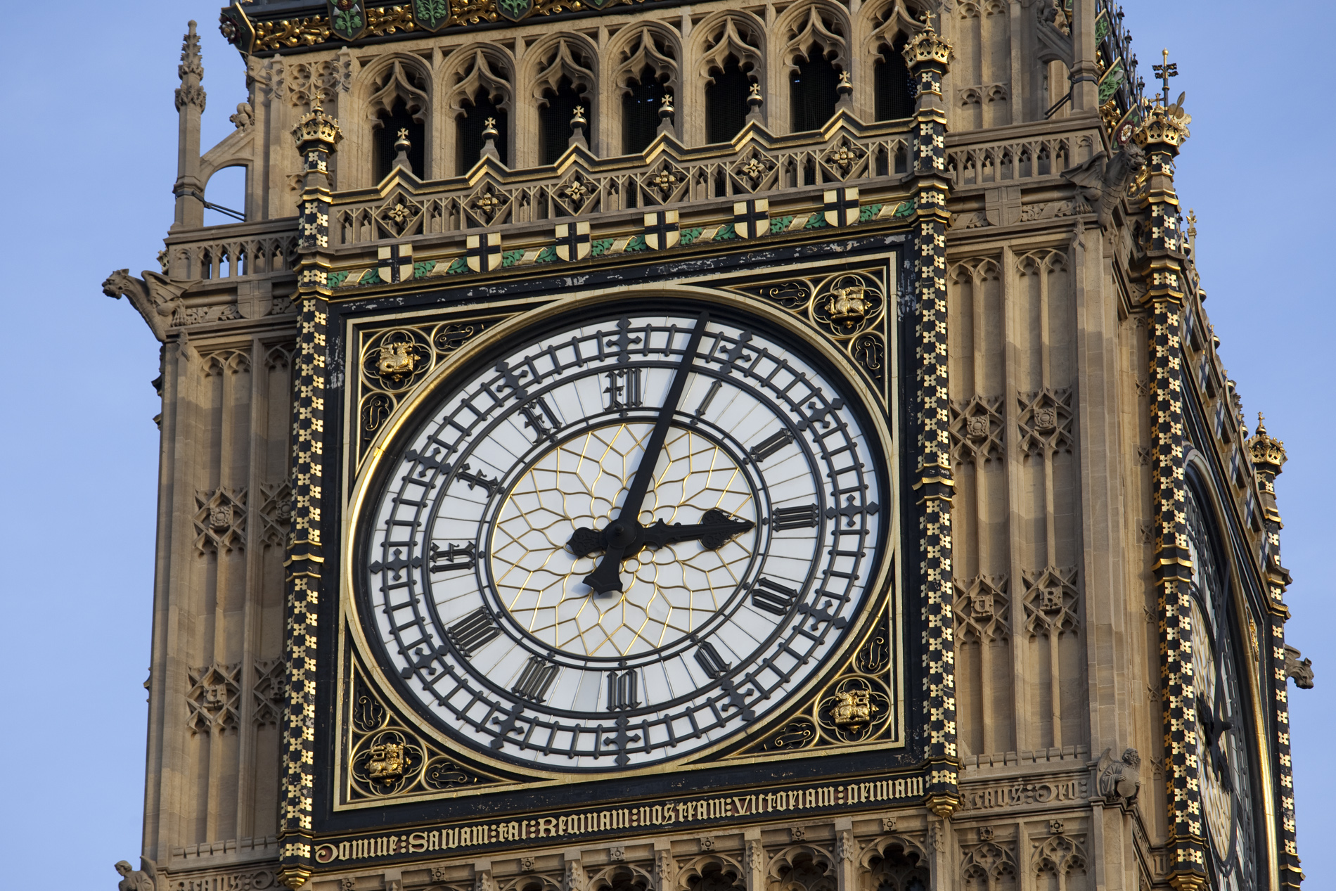
Each big ben clock face measures 7.5 meters and hands are of great length; the hour hand measures 2.7 meters long while the minute and measures 4.3 meters. The numbers on the clock are not far behind with its 50 centimeters of height.

Slide 5
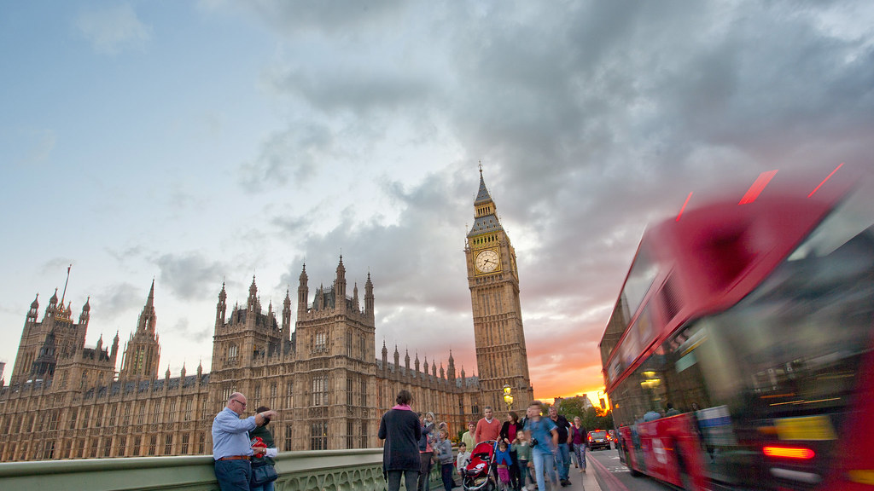
Big Ben has become a very important tourist attraction in the u.k, receiving approximately more tan 15 millón tourists a year. Visitors are allowed to attend debates, watch hearings and tour indside the houses of parliament, but only uk residents are allowed to tour inside the big ben tower.

