Slide 1
The Big Ben

Slide 2
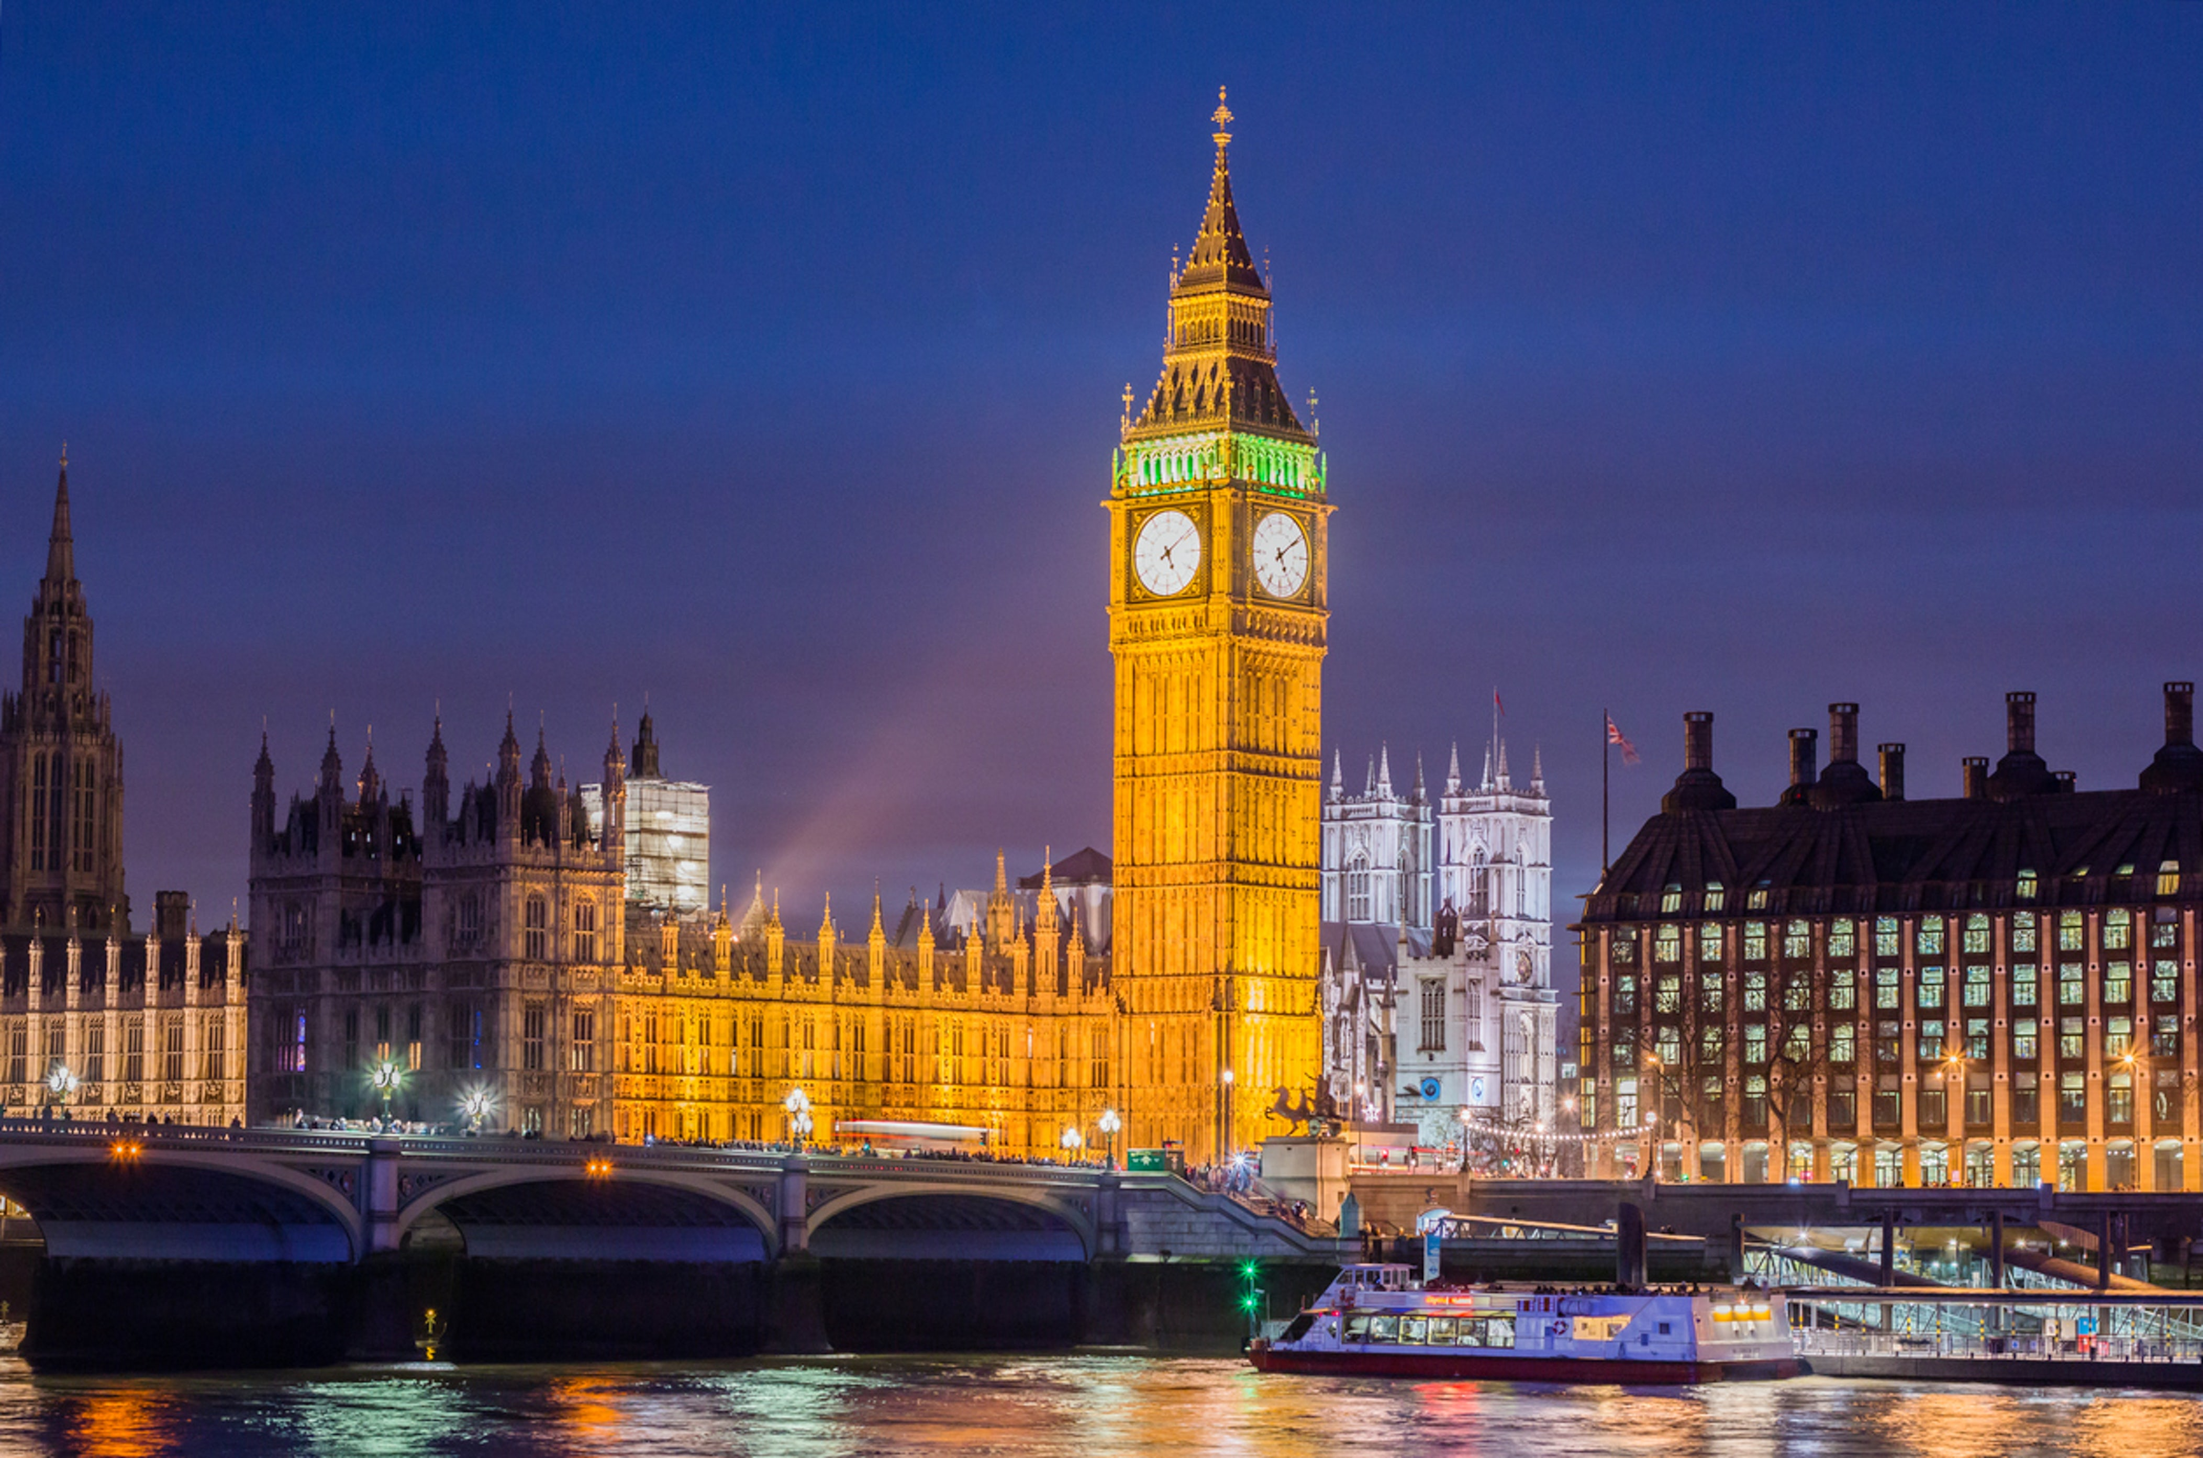

Slide 3
The Elizabeth Tower is over 96 metres (315 ft) high and the turret clock mechanism that drives the clock alone weighs about 5 tons (5.08 tonnes). The clock on it has four faces that are 9 feet (2.7 m) in diameter, making it one of the largest in the world for a clock that chimes and strikes every hour.
According to history, the name Big Ben derives from Big (big in Spanish) due to its imposing size. And Ben in honor of Benjamin Hall, English Secretary of Labor who ordered the construction of the building. The bell that gives its name to Big Ben, one of the best-known symbols of London, turns 150 years old.

