Slide 1
LONDON BRIDGE
Sofia Diaz Ceballos
Colegio O'Farril
4°B

Slide 2
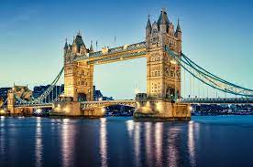
What is the London Bridge?
London Bridge is a bridge in London
that crosses the River Thames, between the Square
Mile and Southwark. It is located between the Cannon Street
Railway bridges and Tower Bridge. On the southern part of the
bridge is Southwark Cathedral and London Bridge Station

Slide 3
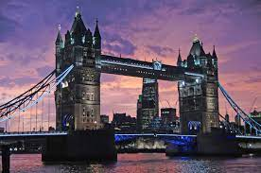
¿Who built the London Bridge?
The current London Bridge was built by
John Mowlem

Slide 4
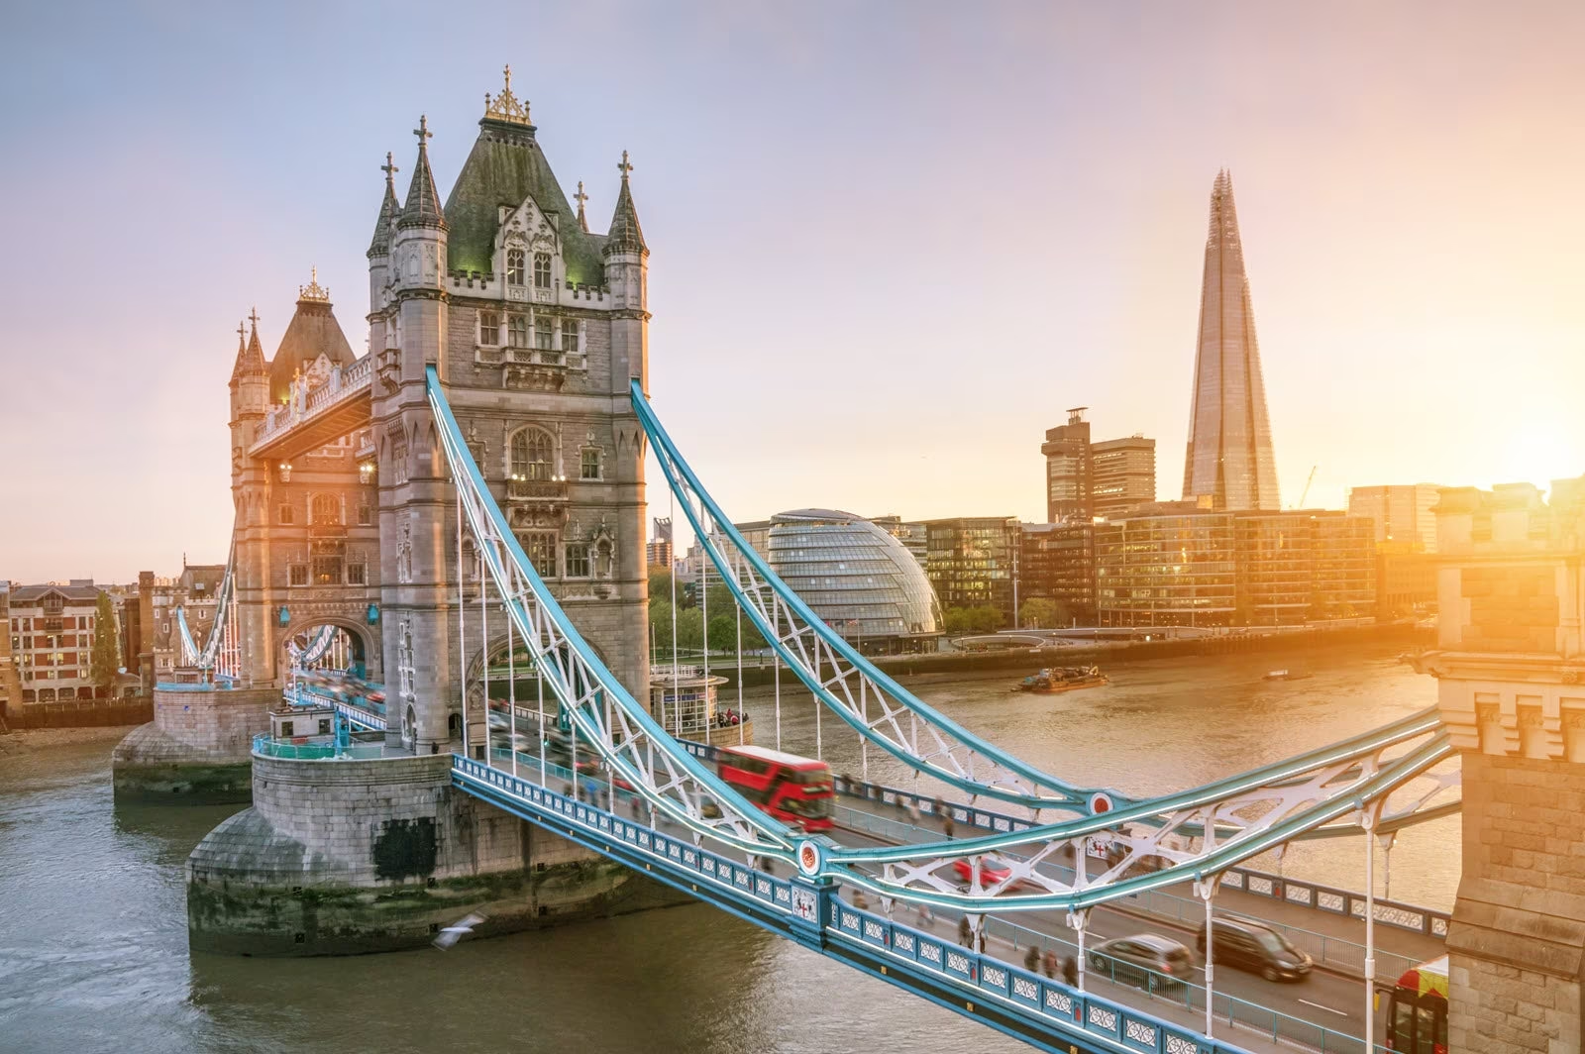
In what time the London Bridge was built?
The current London Bridge was built in1962 to 1972 and opened by Queen Elizabeth ll on March 17,1973

