Slide 1
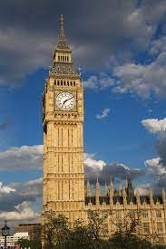
VANESSA VALENTINA
4°B
BIG BEN

Slide 2
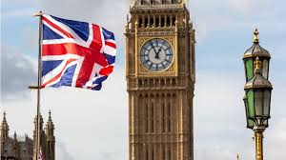
THE BIG BEN IS A SIMBOLIC TOWER LOCATED AT THE NORTH END OF THE PALACE OF WESTMINSTER IN LONDON, ENGLAND.

Slide 3
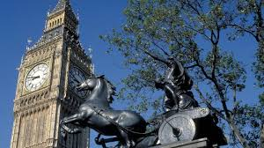
THE TOWER WAS DESIGNED BY AUGUSTUS PUGIN IN A NEO-GOTHIC STYLE.
WHEN COMPLETED IN 1859, ITS CLOCK WAS THE LARGEST AND MOST ACCURATE FOUR-FACED STRIKING AND CHIMING CLOCK IN THE WORLD.

Slide 4

THE TOWER STANDS 316 FEET (96 M). ITS BASE IS SQUARE, MEASURING 40 FEET (12 M) ON EACH SIDE. DIAL OF THE CLOCK ARE 22.5 FEET (6.9 M) IN DIAMETER.

Slide 5
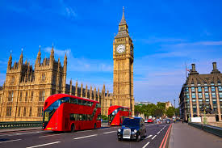
THE TOWER IS A BRITISH CULTURAL ICON RECOGNISED ALL OVER THE WORLD. IT IS ONE OF THE MOST PROMINENT SYMBOLS OF THE UNITED KINGDOM.

Slide 6
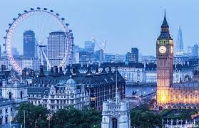
THE CLOCK TOWER HAS BEEN PART OF GRADE 1 LISTED BUILDING SINCE 1970 AND A UNESCO WORLD HERITAGE SITE SINCE 1987.

Slide 7
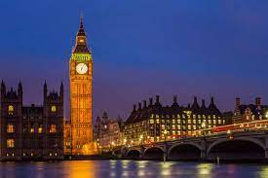
THANK YOU FOR YOUR ATENTION.

