Slide 1
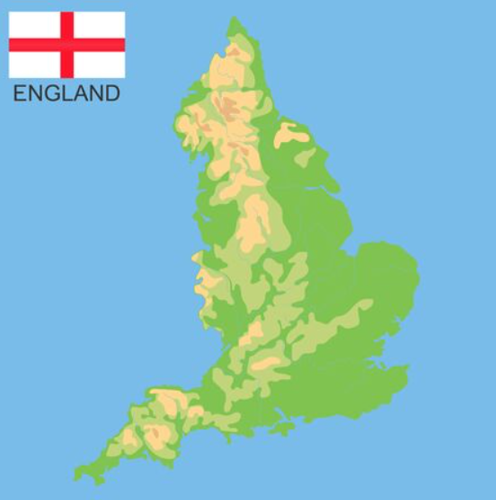
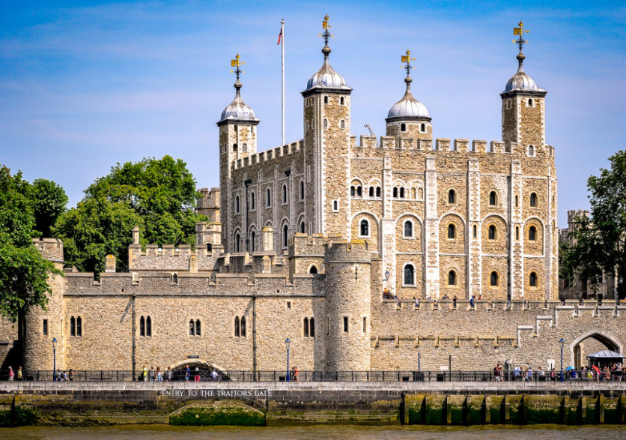
TOWER OF LONDON

Slide 2
Tower of London
The Tower of London is a fortress located on the banks of the River Thames in central London, England.
The tower, also called the Royal Palace and Fortress of Her Majesty, is a complex of buildings, towers and palaces surrounded by two rings of defensive walls.

Slide 3
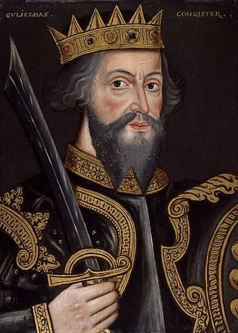
Tower of London
The Tower of London is one of the most important historical pieces in the British capital. Founded by William the Conqueror in 1066.
At that time this Tower was the largest in London, but it was not the only one. Two other castles were built: Chateau de Montfichet and Chateau de Baynard.

Slide 4
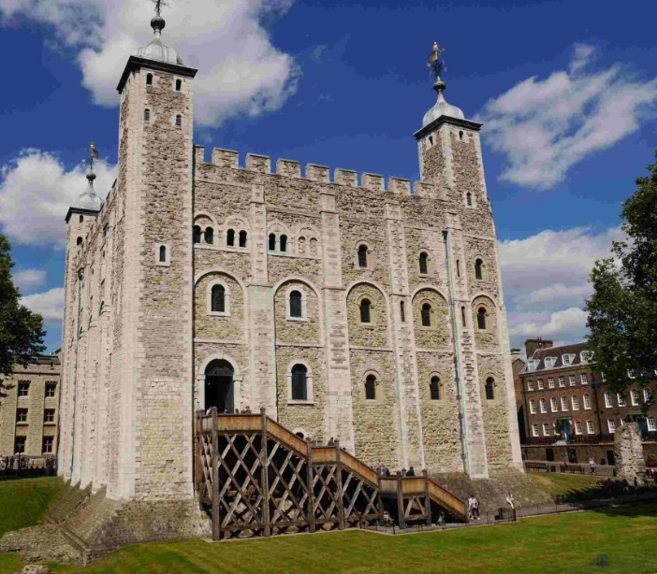
Central courtyard.
The central courtyard is what was originally conceived as a castle. At the corners of the central wall are the Wakefield and Lanthorn towers, which were probably built around 1220.

Slide 5
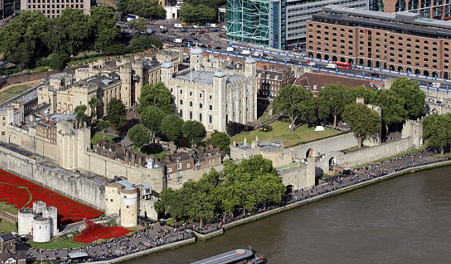
Courtyard
This area is due to King Richard the Lionheart, when he built buildings to the west of the central courtyard;
Many of these buildings have survived and some have even been rebuil

Slide 6
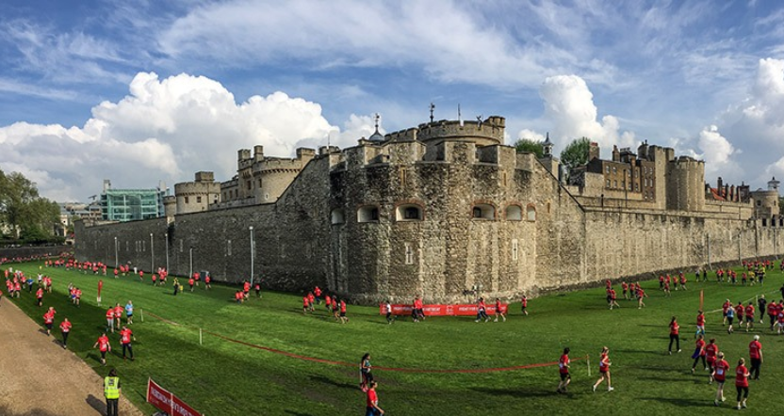
Outdoor patio
During the period of Edward I, the construction of a third courtyard was carried out to surround the already existing complex.
With the Modificing old entrances to the castle and creating new ones, as well as the construction of new towers.

Slide 7

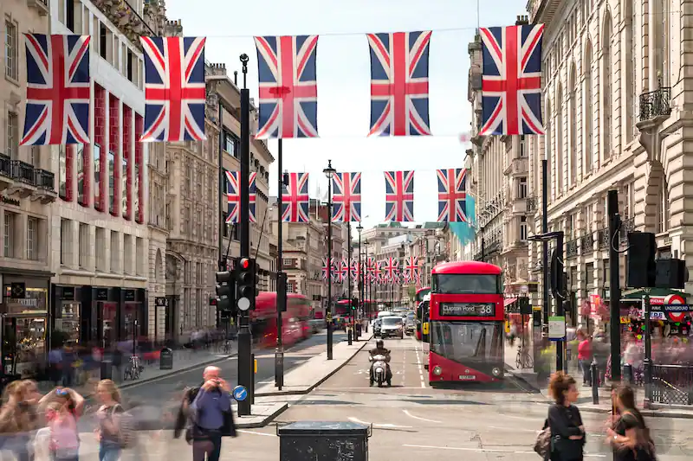
Name: Oliver Matías Ramos Rosado
School: Colegio O'farrill
4°B

