Slide 1
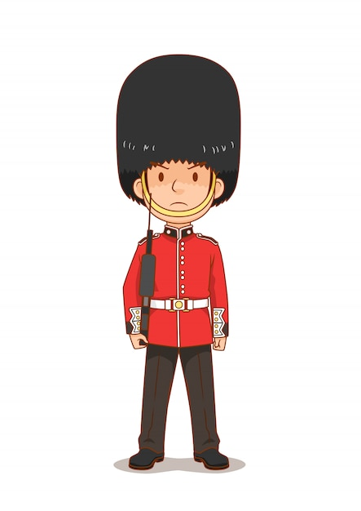


PROJECT:
One famous building in the UK.
SANTIAGO NAVA HEREDIA, 4° B.
Prof. Gachuz Sandoval Víctor Hugo.
07/11/ 2023.

Slide 2
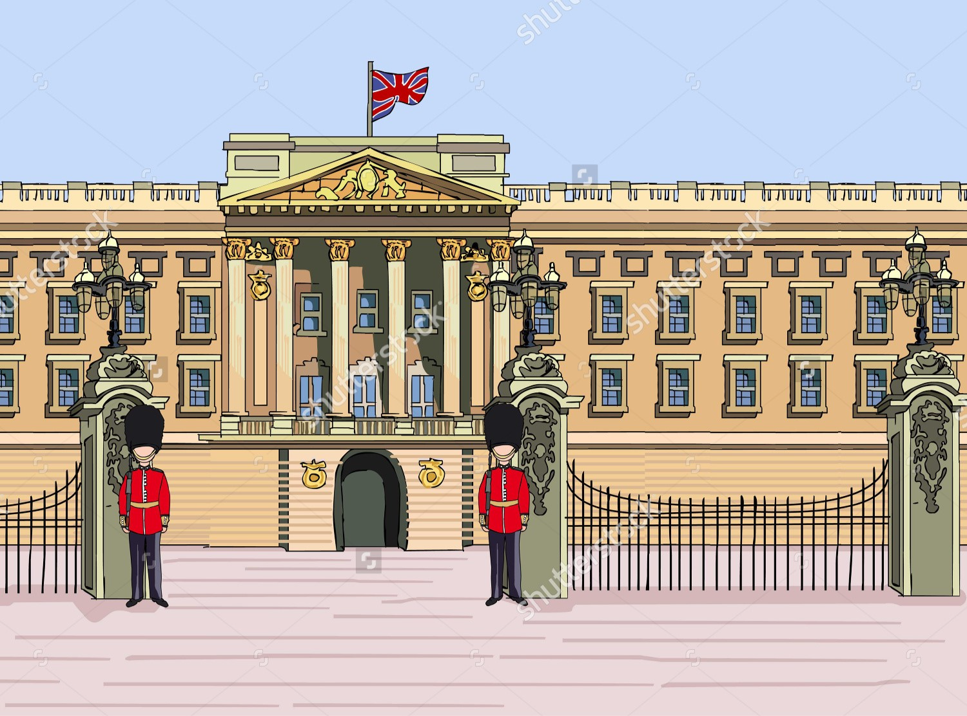
Buckingham Palace
Buckingham Palace has been the London home of the British king or queen since 1837. It is used by Queen Elizabeth II as her official residence, or place to stay. The queen and her family live in the palace for some of the year, but it is also used for important events, meetings, and receptions. Parts of the palace are open to visitors in August and September.
The palace has 775 rooms, including 188 staff bedrooms and 78 bathrooms. There are 92 offices, where the queen, her office staff, and family all work. State banquets are held in the ballroom. There are 19 State Rooms that are used to entertain official guests.

Slide 3
Buckingham Palace
Every summer the queen holds three garden parties on the grounds of the palace. Some 30,000 people are invited to the parties each year.
Buckingham House was bought by King George III for his wife, Charlotte, in 1761. In 1825 King George IV decided to change the house into a palace, but the building project took many years. Queen Victoria became the first sovereign to live in Buckingham Palace, in 1837.

