Slide 1
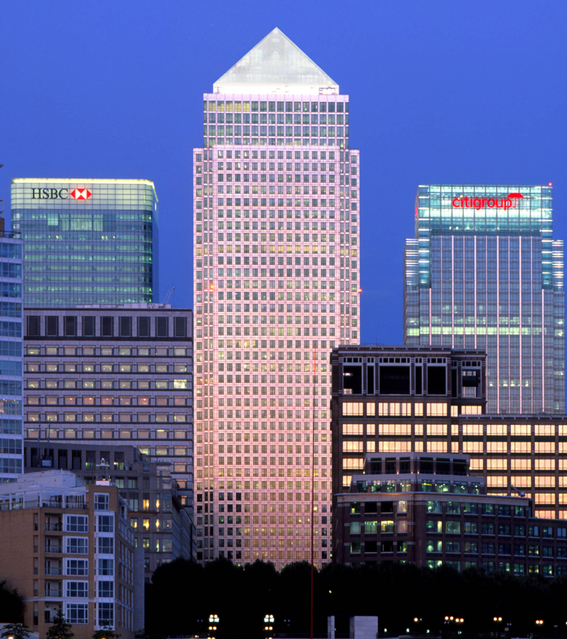

ONE CANADA SQUARE
MARIA FERNANDA HERNANDEZ DOMINGUEZ 4 A

Slide 2
ONE CANADA SQUARE
One Canada Square is a skyscraper in Canary Wharf, London. It is the third tallest building in the United Kingdom at 770 feet (235 m) above ground level, and contains 50 storeys. It achieved the title of the tallest building in the UK upon completion in 1991 and held the title for 21 years until the completion of The Shard (310m) in 2012.

Slide 3
One Canada Square is primarily used for offices, though there are some retail units on the lower ground floor. There is no observation floor. It is a prestigious location for offices and as of October 2017 was completely let.
The building is recognised as a London landmark, and it has gained much attention through film, television, and other media as one of the tallest buildings in the United Kingdom.

Slide 4
CONSTRUCTION
Construction on the tower began in 1988. Construction was given to Sir Robert McAlpine & Sons in association with EllisDon of Toronto, but they were slow at building the tower, partly due to building workers going on strike in the summer of 1989, so Lehrer McGovern took over. Lehrer McGovern contracted out most of the work to Balfour Beatty because the Canary Wharf Tower was a difficult building to build. In total, about 27,500 metric tonnes of British steel and 500,000 bolts were used during construction.Construction also involved building a huge cofferdam to seal construction from water. It also involved driving 222 piles into the ground at 23 metres deep.

Slide 5
General information
Type | Commercial
Location | Canary Wharf London, England, UK
Coordinates | 51°30′18″N 0°01′10.6″W
Construction started | 1988
Completed | 1991
Cost | £624 million
Owner | Canary Wharf Group plc (current majority shareholder is Songbird Estates plc)
Management | Canary Wharf Group plc

Slide 6
Opening
In August 1991, One Canada Square was completed and open for business. His Royal Highness The Duke of Edinburgh officially opened One Canada Square on the morning of 26 August 1991, and unveiled a commemorative plaque at the entrance to the building. Hundreds of construction workers attended the opening ceremony.

Slide 7
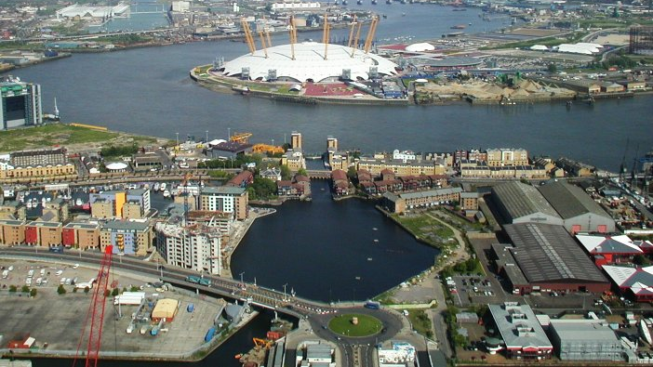

Slide 8
