Slide 1
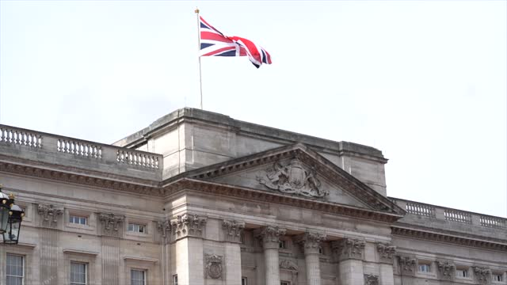
BUCKINGHAM PALACE
UK BUILDINGS

Slide 2
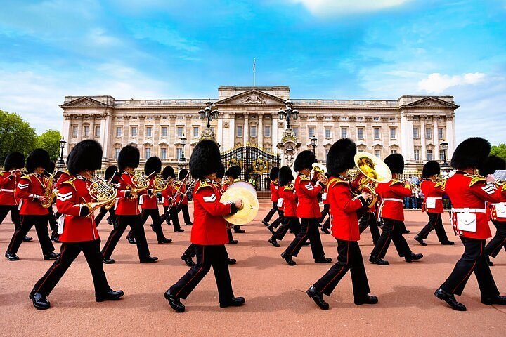
BUCKINGHAM PALACE
BUCKINGHAM PALACE IS THE OFFICIAL RESIDENCE OF THE BRITISH MONARCHY IN LONDON AND ONE OF THE MOST FAMOUS BUILDINGS IN THE UNITED KINGDOM.

Slide 3
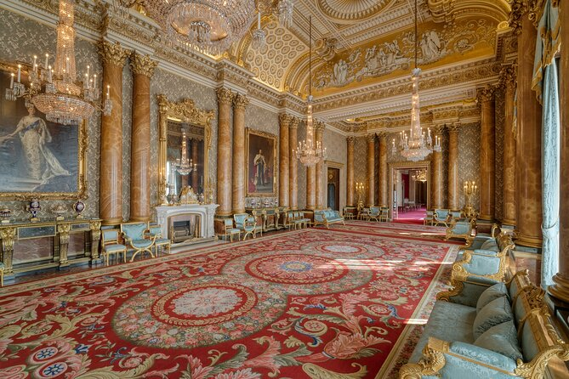
BUCKINGHAM PALACE
IT WAS BUILT IN 1703 AS A COUNTRY HOUSE FOR THE DUKE OF BUCKINGHAM, AND IN 1837 THE PROPERTY PASSED INTO THE HANDS OF QUEEN VICTORIA.

Slide 4
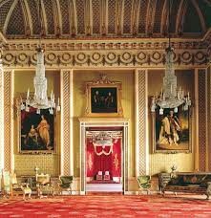
BUCKINGHAM PALACE
THE ROOMS INCLUDE: THE THRONE ROOM, THE DANCE ROOM AND THE PAINTING GALLERY.
DID YOU KNOW?:
IT IS ESTIMATED THAT ITS PRICE TODAY EXCEEDS 1000 MILLION DOLLARS!!!

Slide 5
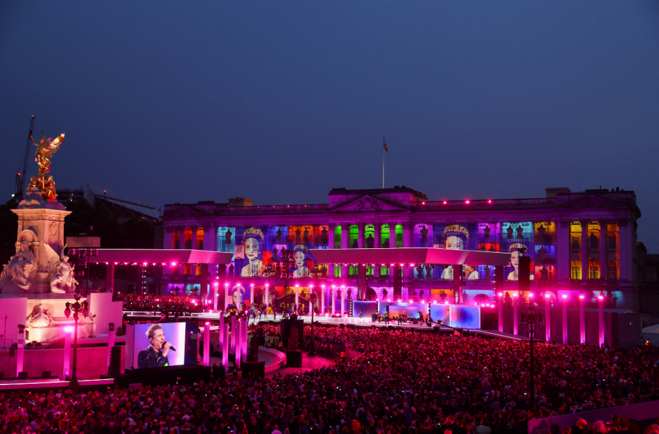
THANK YOU FOR YOUR TIME.

