Slide 1
Big Ben
Matias Delgado Vertiz
English
Teacher Victor
9-11-23

Slide 2
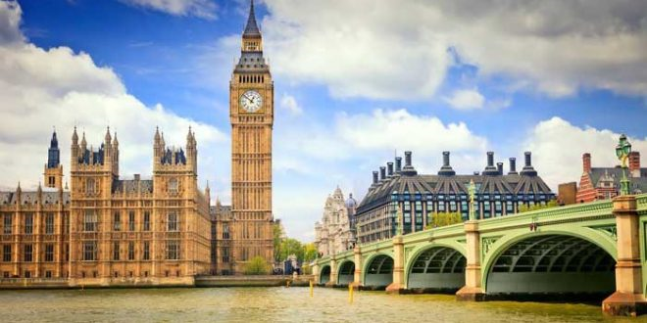
Big Ben History
Big Ben is the nickname of a bell that hangs in the clock tower at the northern end of the Houses of Parliament in Westminser, London, England.
Officially, the tower itself is called Elizbeth Tower.

Slide 3
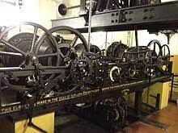
Description
The Big Ben is the must largest clock in the world.
The bell known as Big Ben weighs 13 tons and is the biggest of the five bells in the Elizabeth Tower. It does not use any electricity except for winding and to light the faces so that the clock could be seen when it is dark.

Slide 4
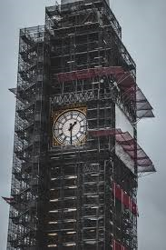
Desing
Completed in 1859, the tower is designed in Pugins Gotic Revival style.
Decorated with natinal emblems of the four countries of the UK: the red and the White rose of Englands Tudor dynasty, the thistle of Scotland, shamrock of Northern Ireland, and leek of Wales.

