Slide 1
The Big Ben
By Santiago Nicolás Avilés Avendaño
4A

Slide 2
The Big Ben
Big Ben is the most famous clock in the world, and it is one of the most popular attractions in London, the British capital.
Its bells have not stopped ringing for 157 years but Big Ben stopped ringing a long time ago and it is believed that in 4 years it will work again.
The Parliament Tower where the clock is located was built in 1898 next to the Palace of Westminster. The clock is more than 106 meters high and the approximate weight of the whole is 8,660 tons.
It is also composed of four clocks with a diameter of seven meters on each of their faces.

Slide 3
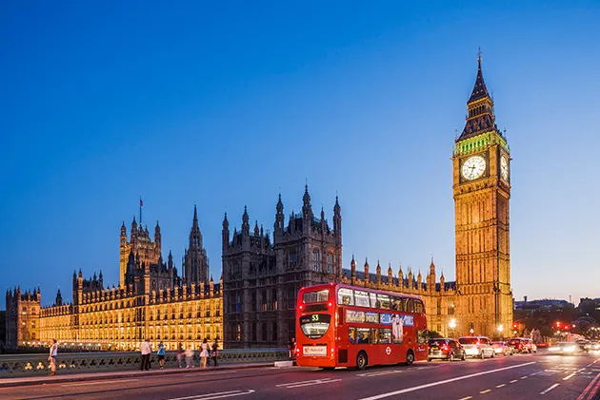
Curious fact:
They knew that the name of the entire clock was never Big Ben, that name is from the enormous bell inside and the true name of the tower was always Elizabeth Tower. It is so called because it was baptized on the occasion of Queen Elizabeth's jubilee.

