Slide 1
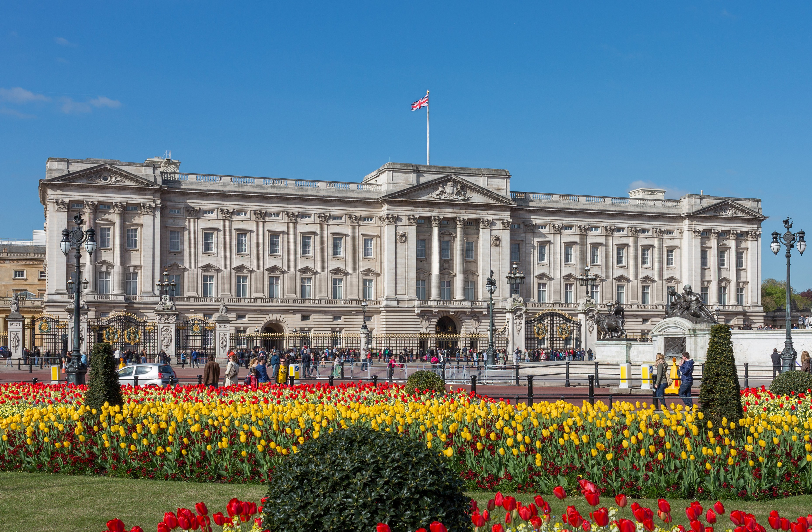
THE BUCKINGHAM PALACE

Slide 2
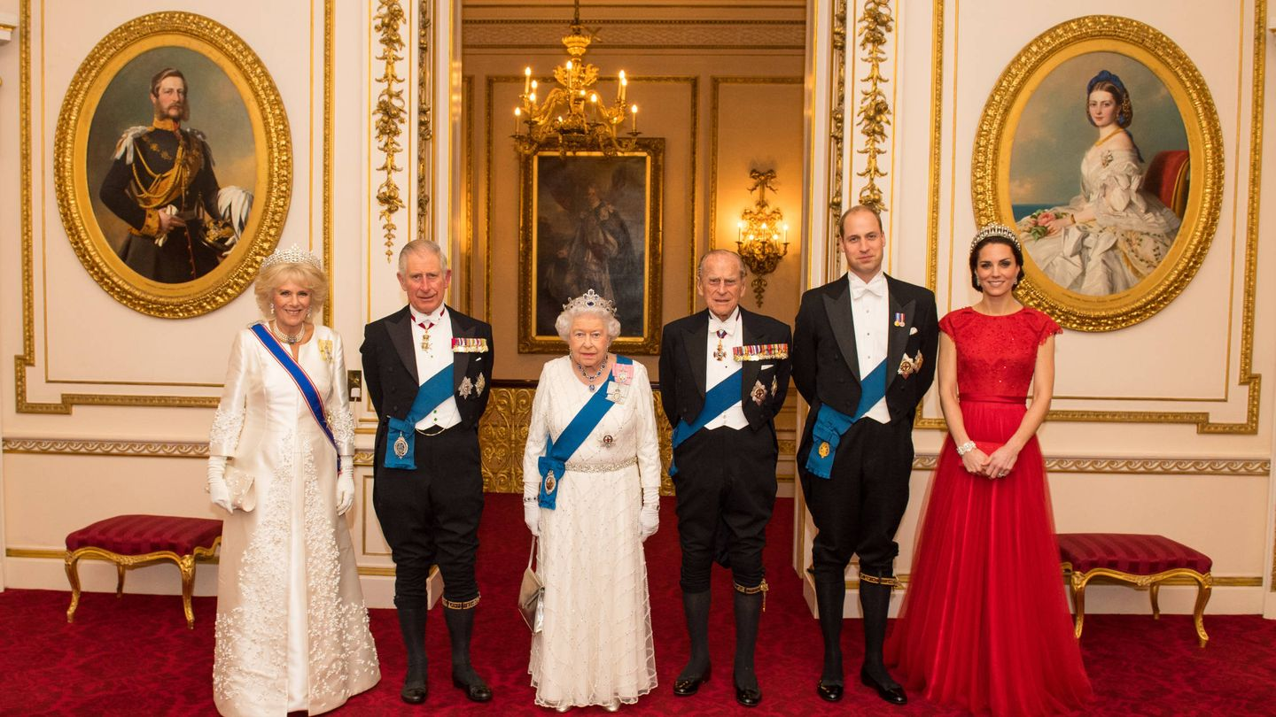
Is a place where the British monarch resides in London.

Slide 3
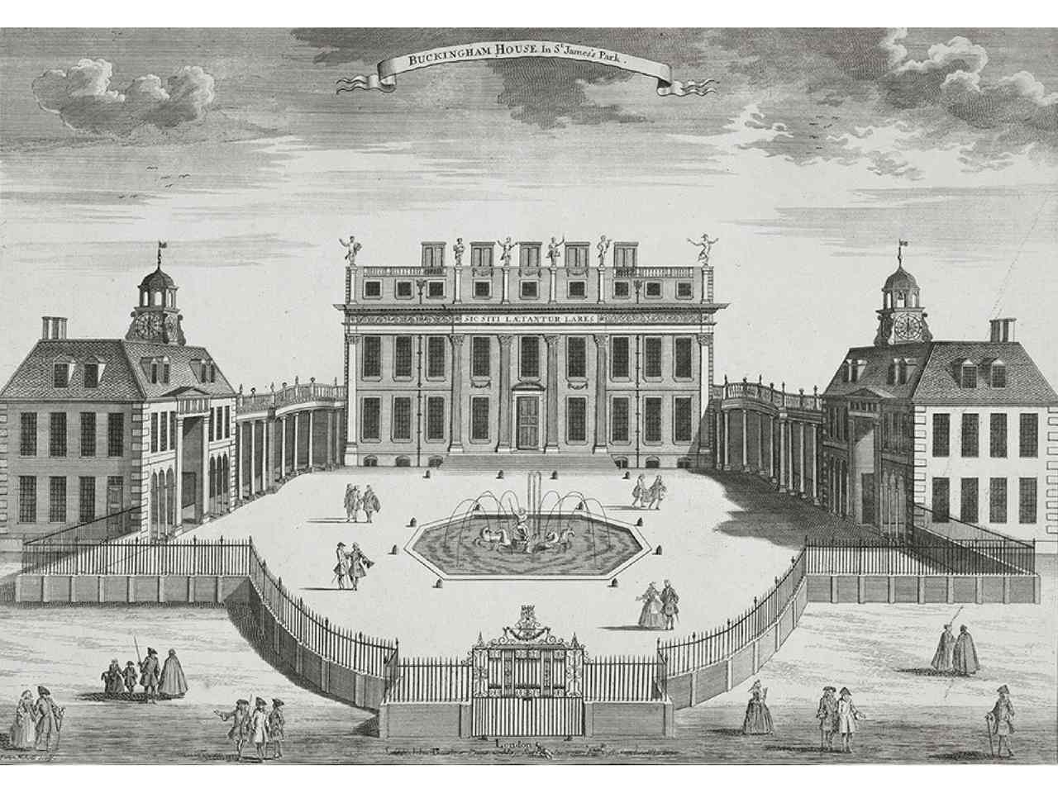
It was a small hotel.

Slide 4
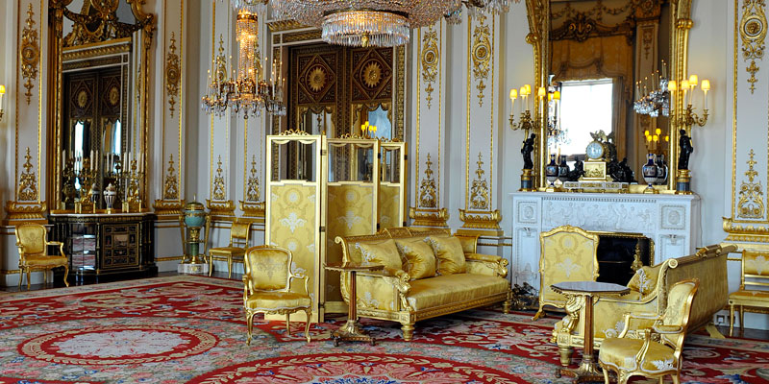
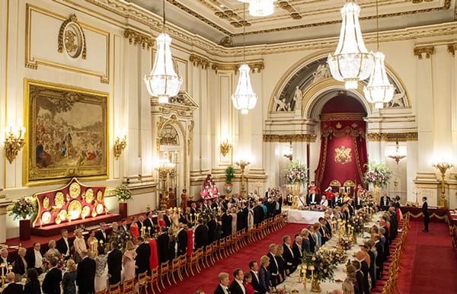
More than 450 people work there.

Slide 5
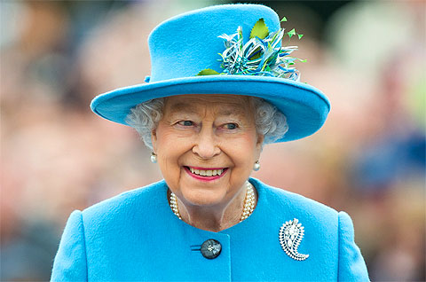
The Queen Isabel II lived here for 70 years.

Slide 6
THANKS FOR YOUR ATTENTION.
CAROLINA MARTINEZ JIMENEZ
4º A

