Slide 1
Big ben
Alessandro García Gutiérrez

Slide 2
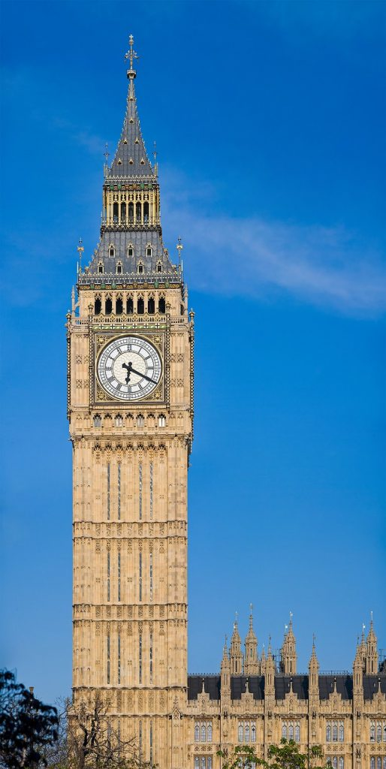
How tail is it the Big Ben
The BigBen tail 96 m

Slide 3
Where year build the Big Ben?
1859
Big Ben was built in the Palace of Westminster clock tower in 1859. It has since become one of Britain’s most well-known bells. The BBC broadcast its iconic chimes for the first time on New Year’s Eve in 1923

Slide 4
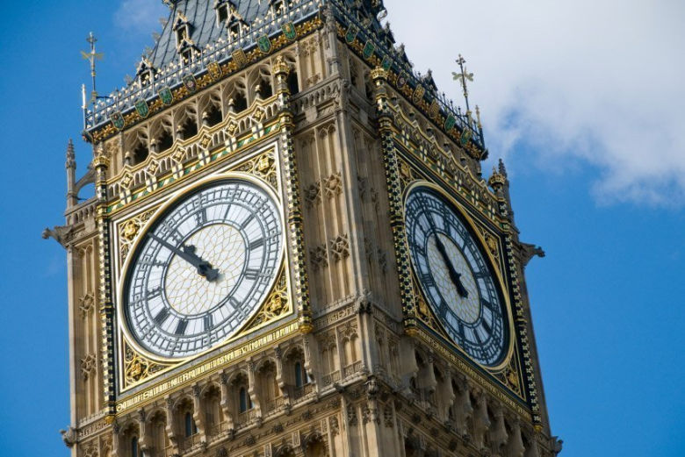
How mani persons visit the Big Ben each year
According to the latest figures, the landmark has around 5.9 million visitors annually. It is estimated that over 500 people an hour visit the tower at peak times, with people flocking from all over the world to witness this iconic landmark.

Slide 5
How main time did it take to build it?
Big Ben is wound three times a week, and the winding takes over an hour. Big Ben is accurate to within two seconds per week. The pendulum is adjusted by adding pennies made before the decimalization of the United Kingdom’s currency in 1971 to the weight. See more

Slide 6
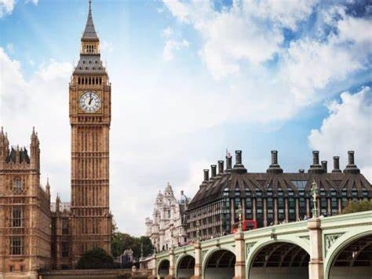
How located the Big Ben?
The Big Ben clock is located next to the Parliament and opposite the London Eye

Slide 7
4*A NL7
Thursday November 9 2023

