Slide 1
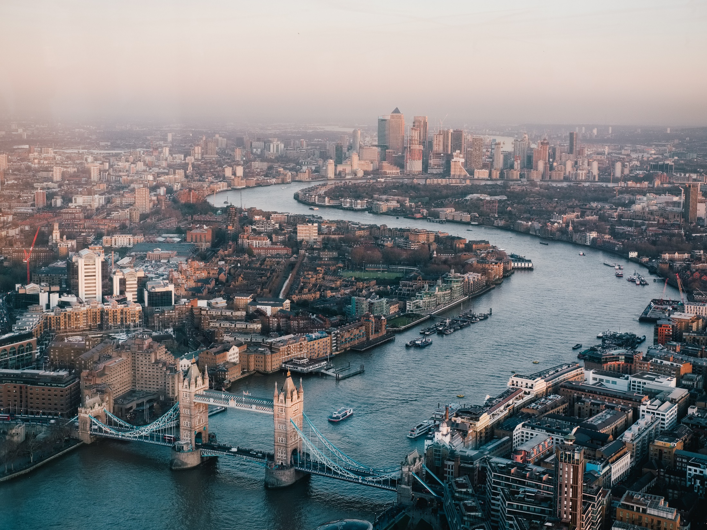
XIMENA AVILA CORTES
4-A

Slide 2

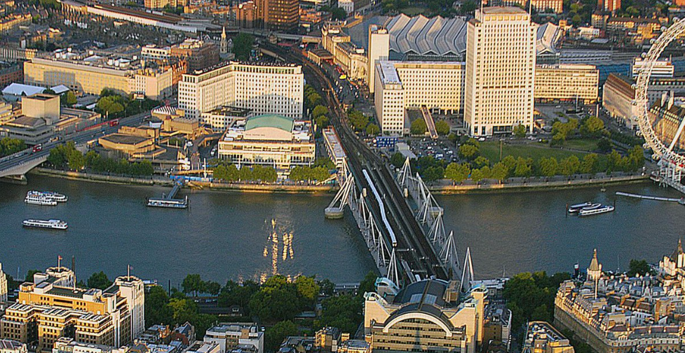
The history of Southbank Centre starts with the Festival of Britain, held in 1951. In what was described as "a tonic for the nation"

Slide 3
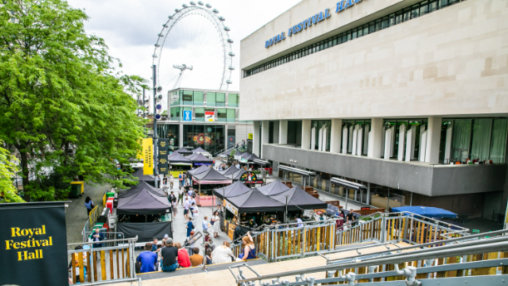
It is located on the south
bank of the River Thames.
It is one of the largest art centers in europe.
The complex presents music, literature and dance shows.
It has three performance halls and an art gallery.

Slide 4
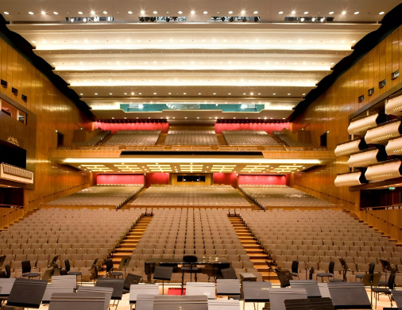
They do educational programs, workshops and talks for free.
Every year important art exhibitions are presented.
The center presents approximately 2,000 shows and events a year.

Slide 5
XIMENA AVILA CORTES
4-A

