Slide 1
Wembley stadium
Julieta Aguilera López
4 “A”
Profesor Víctor

Slide 2
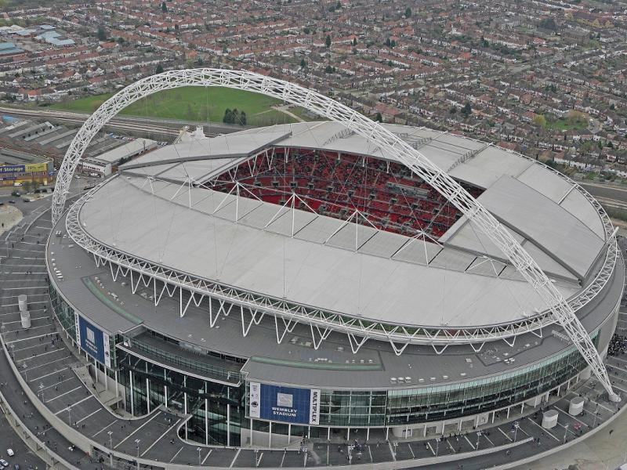
Wembley Stadium is a football stadium located in the city of London, England.

Slide 3
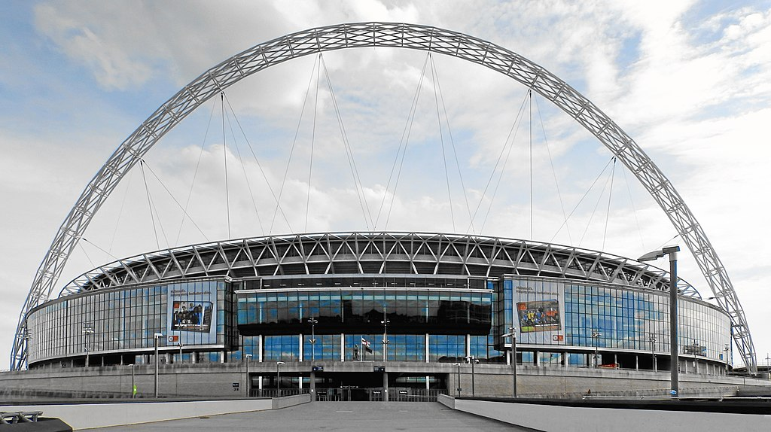
The history of Wembley Stadium When building Wembley Stadium in the United Kingdom, it was intended to be a multifunctional space, since it had a soccer field and an athletics track; It was designed specifically for the British Empire Exhibition of 1924 and 1925.

Slide 4
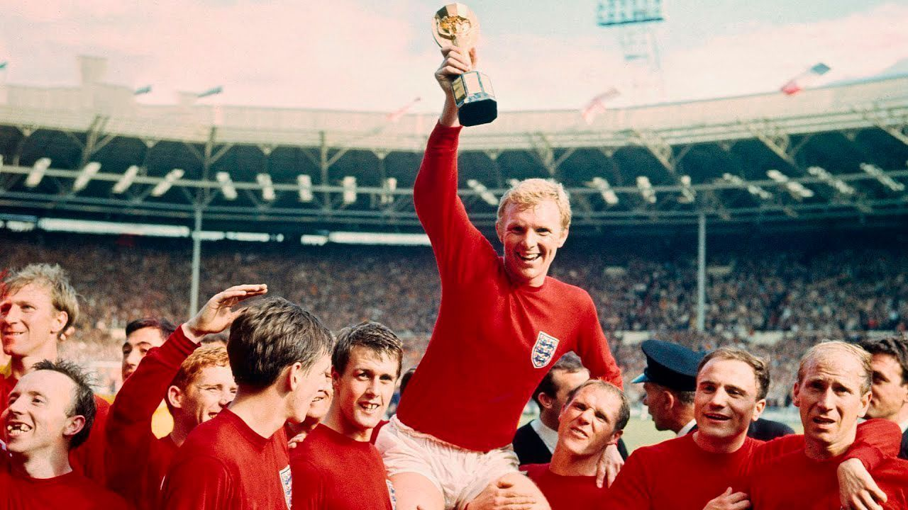
Sporting events at Wembley Stadium, United Kingdom
Wembley Stadium has seen the only English team that has been world champion play.

Slide 5
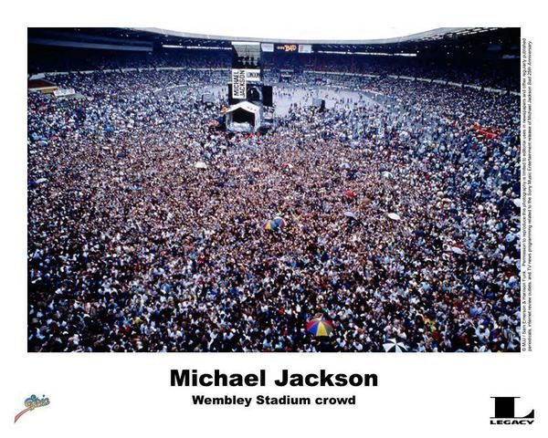
Wembley Stadium has served as a concert venue for artists of international stature. Queen, Michael Jackson, and the Rolling Stones in 1990 have performed in this wonderful place.

Slide 6
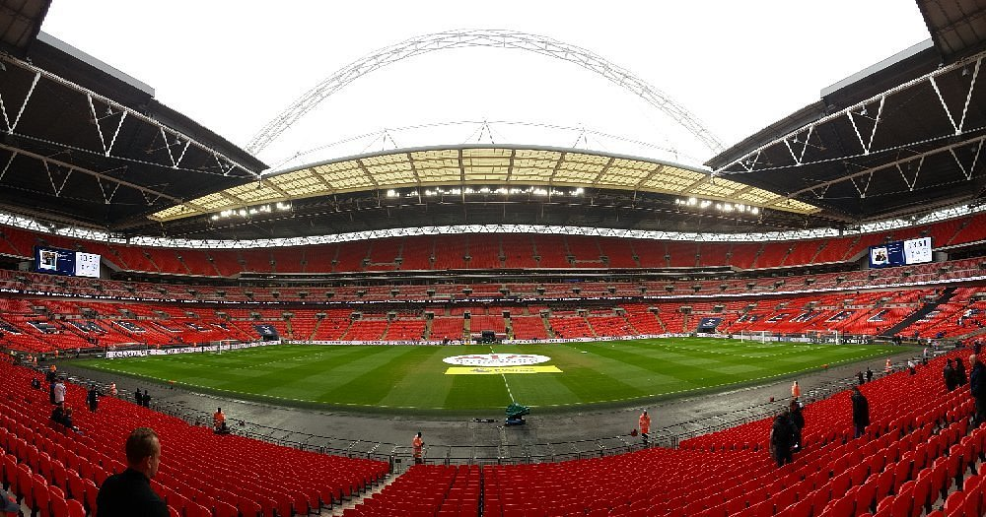
The stadium has a circumference of 1 kilometer, and if it were a seamlessly closed space you could fill it with 4 million cubic meters of liquid or twenty-five thousand double-decker buses.

Slide 7
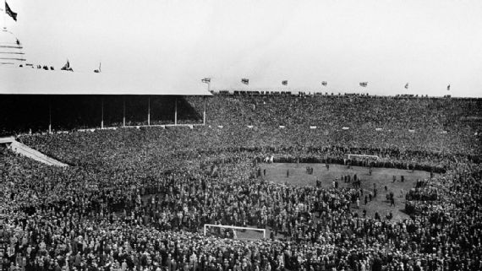
The first match The first football match that Wembley hosted was the FA Cup final in 1923.

