Slide 1
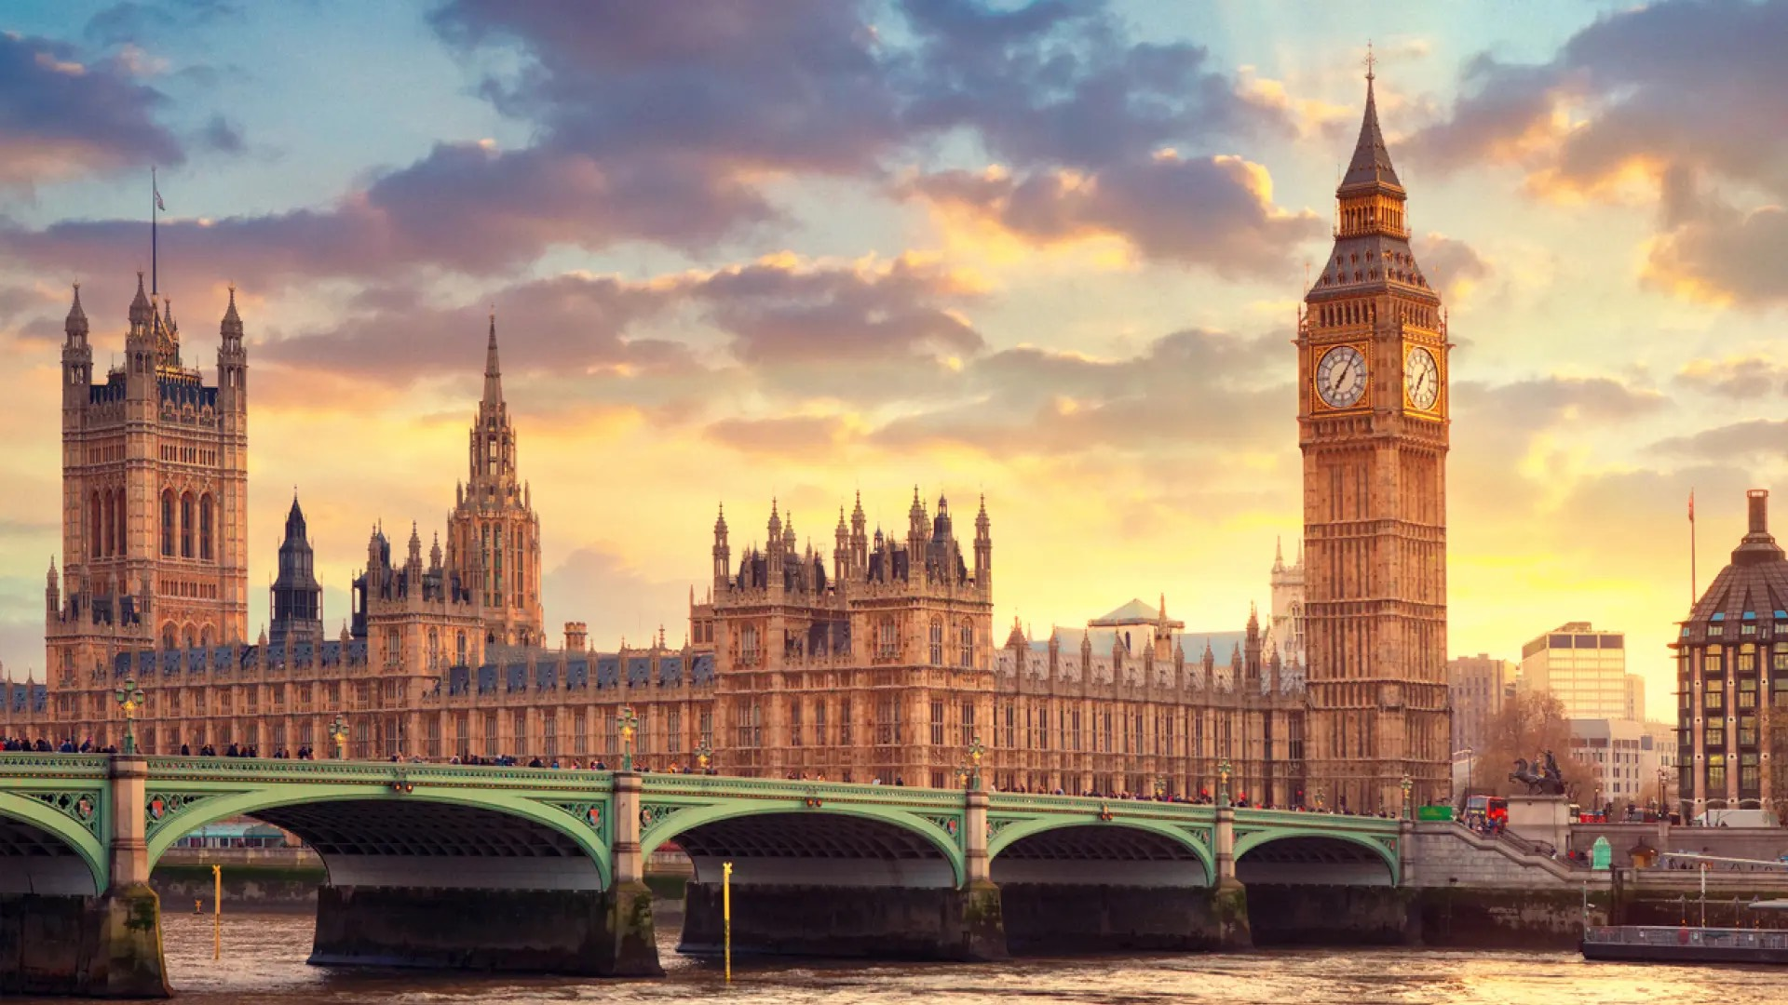
THE BIG BEN
Nov.3th.2023
By: Leonardo Daniel Sánchez Perrín

Slide 2
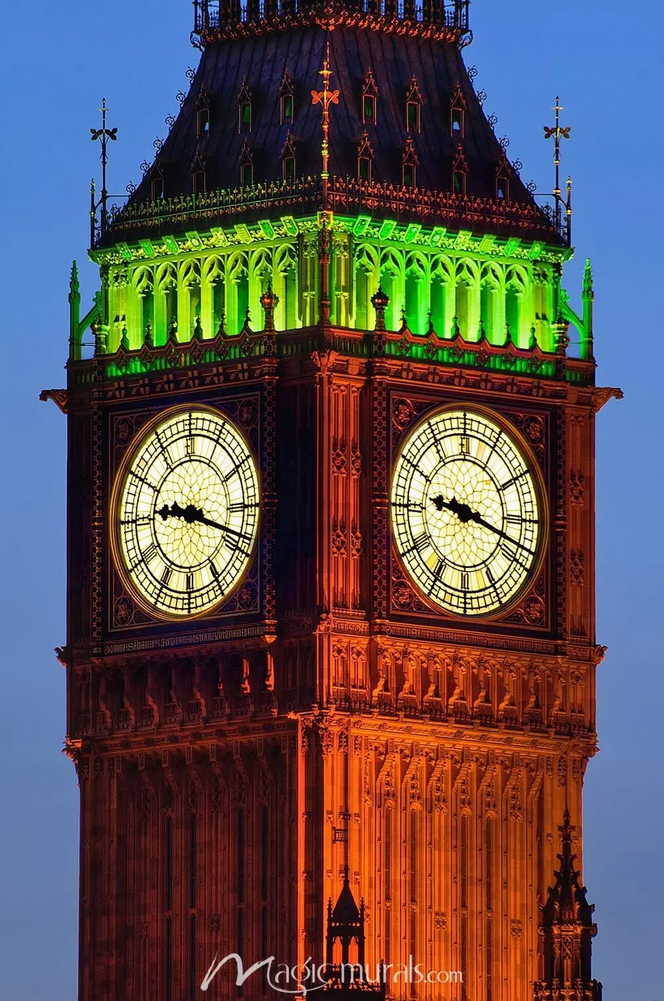
What is the Big Ben?
THE BIG BEN
The Big Ben is the House of Parliament and Elizabeth Tower. It is London´s most iconic building. Technically, Big Ben is the name given to the massive bell inside the clock tower, which weighs more than 13 kg. It really looks great at night when the four clock faces are illuminated.

Slide 3
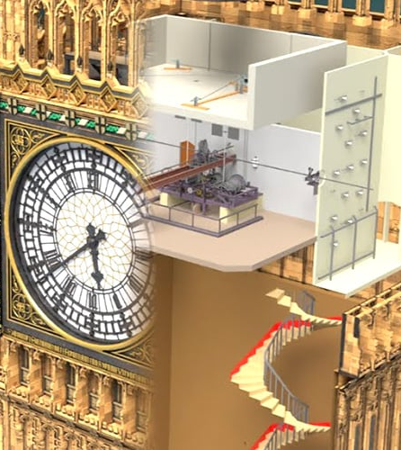
How does it works?
The Big Ben´s clock works thanks to the “Double Three-legged Gravity Escapement” designed by Edmund Beckett Denison to solve the problem of the clocks accuracy affected by the outside pressure like the wind on the clock hands. Now it compensates for the effects of outside pressure on the mechanism and It works perfect.
IMPORTANT FACTS
The mechanism weighs 5 tonnes
Is made of cast iron
The pendulum weighs 310 kgs
There are four bells fixed and struck by hammers from outside. Their notes all combine to form the famous tune: “E” “G” “F#” “B”

Slide 4
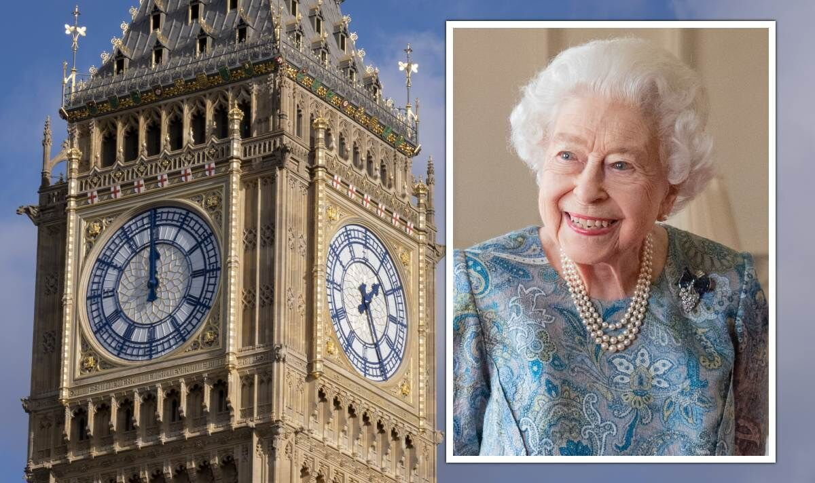
BIG BEN´S REAL NAME
The tower itself was formally known as St. Stephen Tower until 2012 when it was renamed Elizabeth Tower on the occasion of Elizabeth II´s Diamond Jubilee, celebrating 60 years on the British throne

Slide 5
Thank you!

