Slide 1
The London Eye
Renata Nirel Hernández Medina 4ºA
Teachers Name:Gachuz Sandoval Victor Hugo

Slide 2
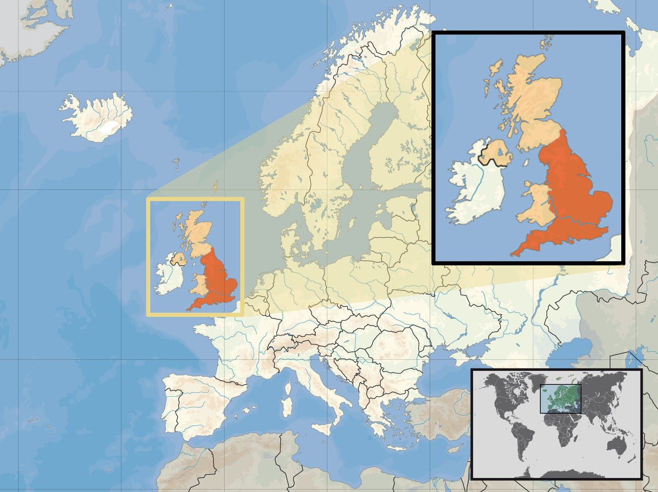
The London Eye is the most popular paid tourist attraction in London, attracting nearly 4 million visitors annually.
In addition to having been awarded nationally and internationally, up to 85 times, for its surprising architectural and tourist quality, and for being an engineering achievement.

Slide 3
The London Eye is a Ferris wheel located on the south bank of the River Thames. At 135 meters high and 120 meters in diameter, it offers visitors a 360-degree view of the capital.
Construction began in 1998 and the main components of the attraction were built off-site and shipped to the construction site where the wheel was assembled. The London Eye was officially opened on December 31, 1999.

Slide 4
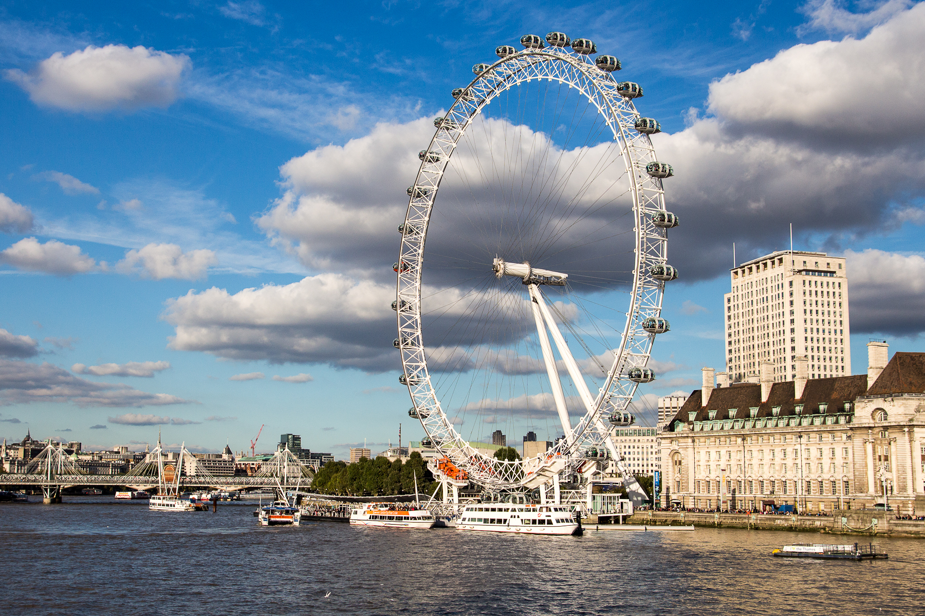
The London Eye was originally known as the Millennium Wheel, but was changed to the London Eye in 2011.

Slide 5
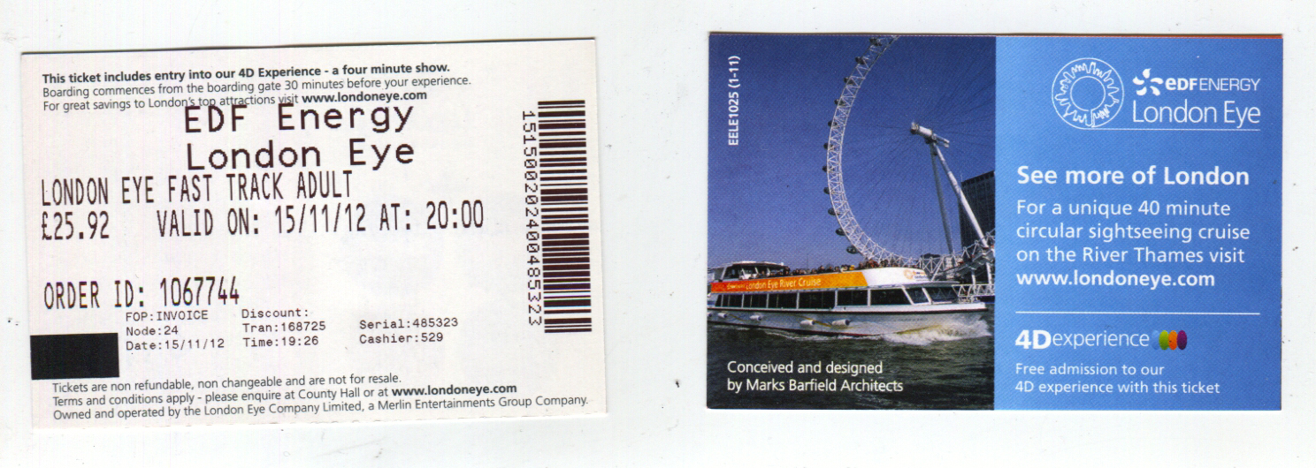
The fast-track ticket for the London Eye which, from €56, in pesos mx 1048, is ideal if you have a flexible budget and value your time.
You can reserve a time to access the Ferris wheel and, this way, better organize your trip.

Slide 6
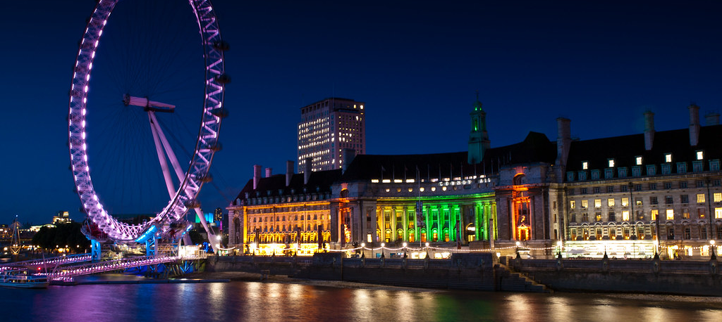
Creators of the London Eye
Julia Barbara Barfield , David Marks, Nic Bailey , Steve Chilton , Malcolm Cook , Frank Anatole and Mark Sparrowhawk had the idea for the London Eye.

Slide 7
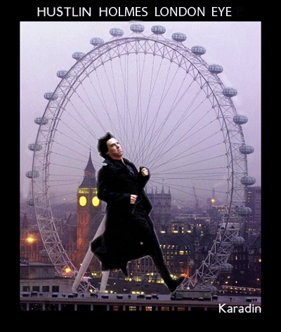
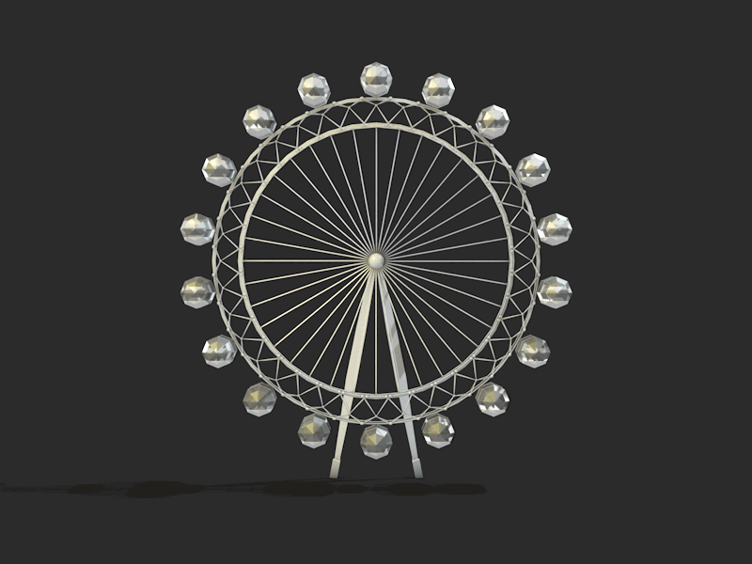
¡Thanks for your attention!

