Slide 1

Big Ben
Famous building
Dannika Sofia Quintana Ortiz
4 A
Inglés
Colegio O´farrill

Slide 2
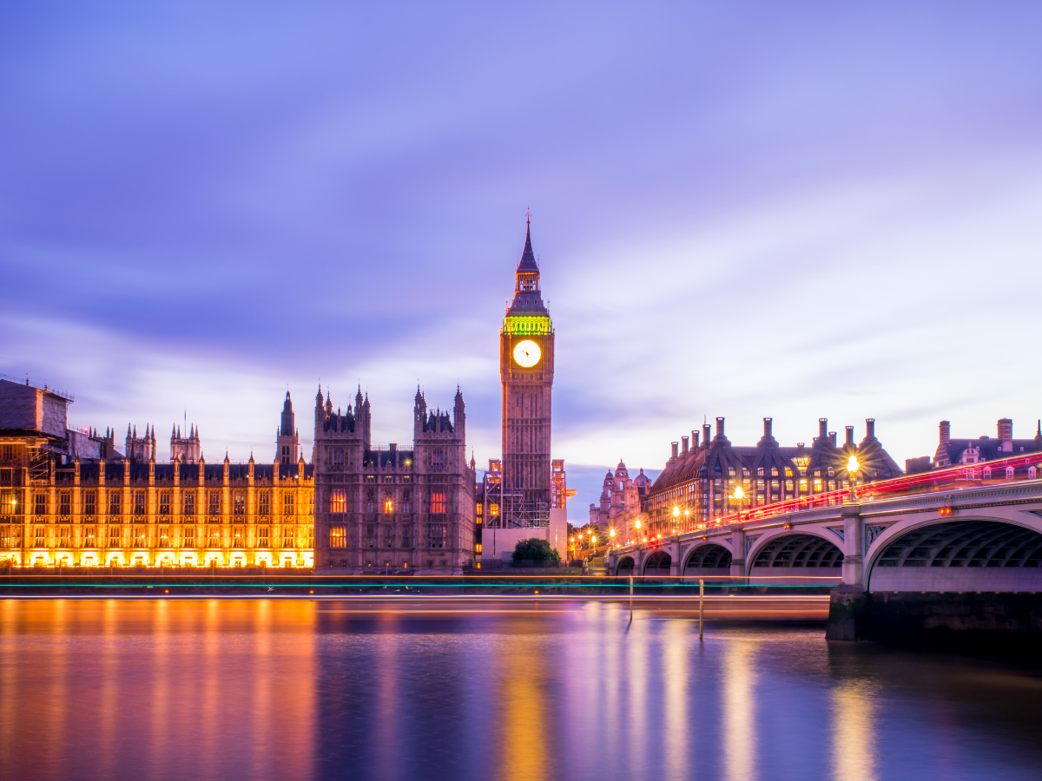
Big Ben
¿What it is Big Ben?
Big Ben is the nickname of a bell that hangs in the clock tower at the northern end of the Houses of Parliament in Westminster, London, England.
Officially, the tower itself is called Elizabeth Tower.
Previously known as just the Clock Tower.
Big Ben is one of England’s best-known landmarks.

Slide 3
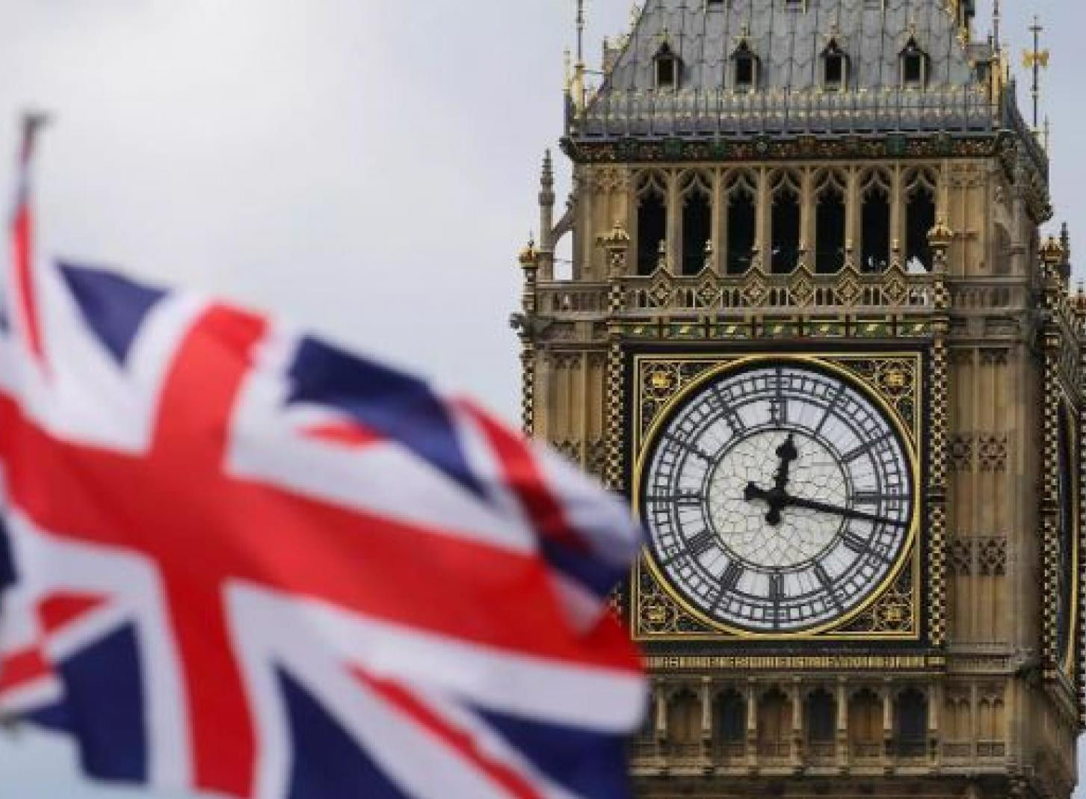
¿Who built the Big Ben?
Designed by Edmund Beckett Denison, the clock took 13 years to build and it was completed in 1859.

Slide 4
At the moment Big Ben
It has become one of the most prominent symbols of the United Kingdom and is often in the establishing shot of films set in London.
Since August 2017, repair work is being done on the clock, which should have taken four years but it will reopen 2023.
Big Ben no longer rings out every hour. But heard on special occasions, such as the New Year.

Slide 5
Thank´s for your atentión

