Slide 1
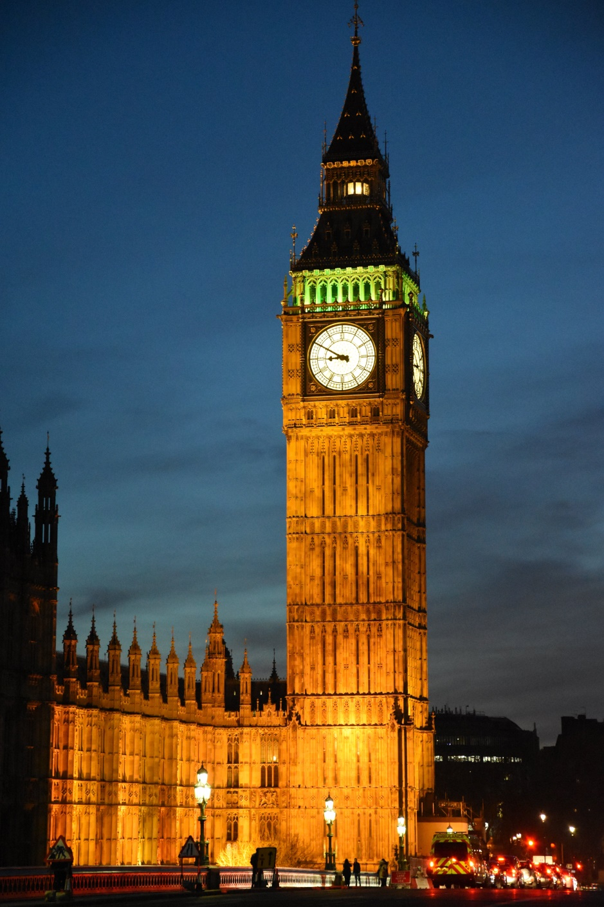
BIG BEN
ALUMNO: LUIS XAVIER SALMERON SOLORIO
4°A
TEACHER: VICTOR

Slide 2
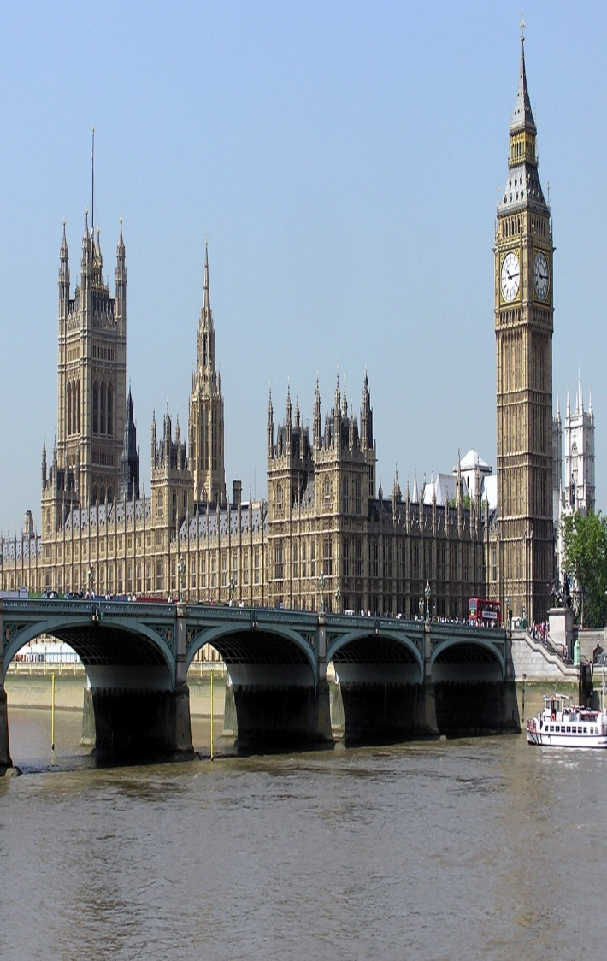
BIG BEN
Is the most representative tower in the city of London and is home to one of the largest mechanical clocks in the world. Big Ben is the name by which the tower is known worldwide, but officially this name is due to the main bell , which weighs about 13.8 tons (The first one weighed 16 tons but broke and was replaced).

Slide 3
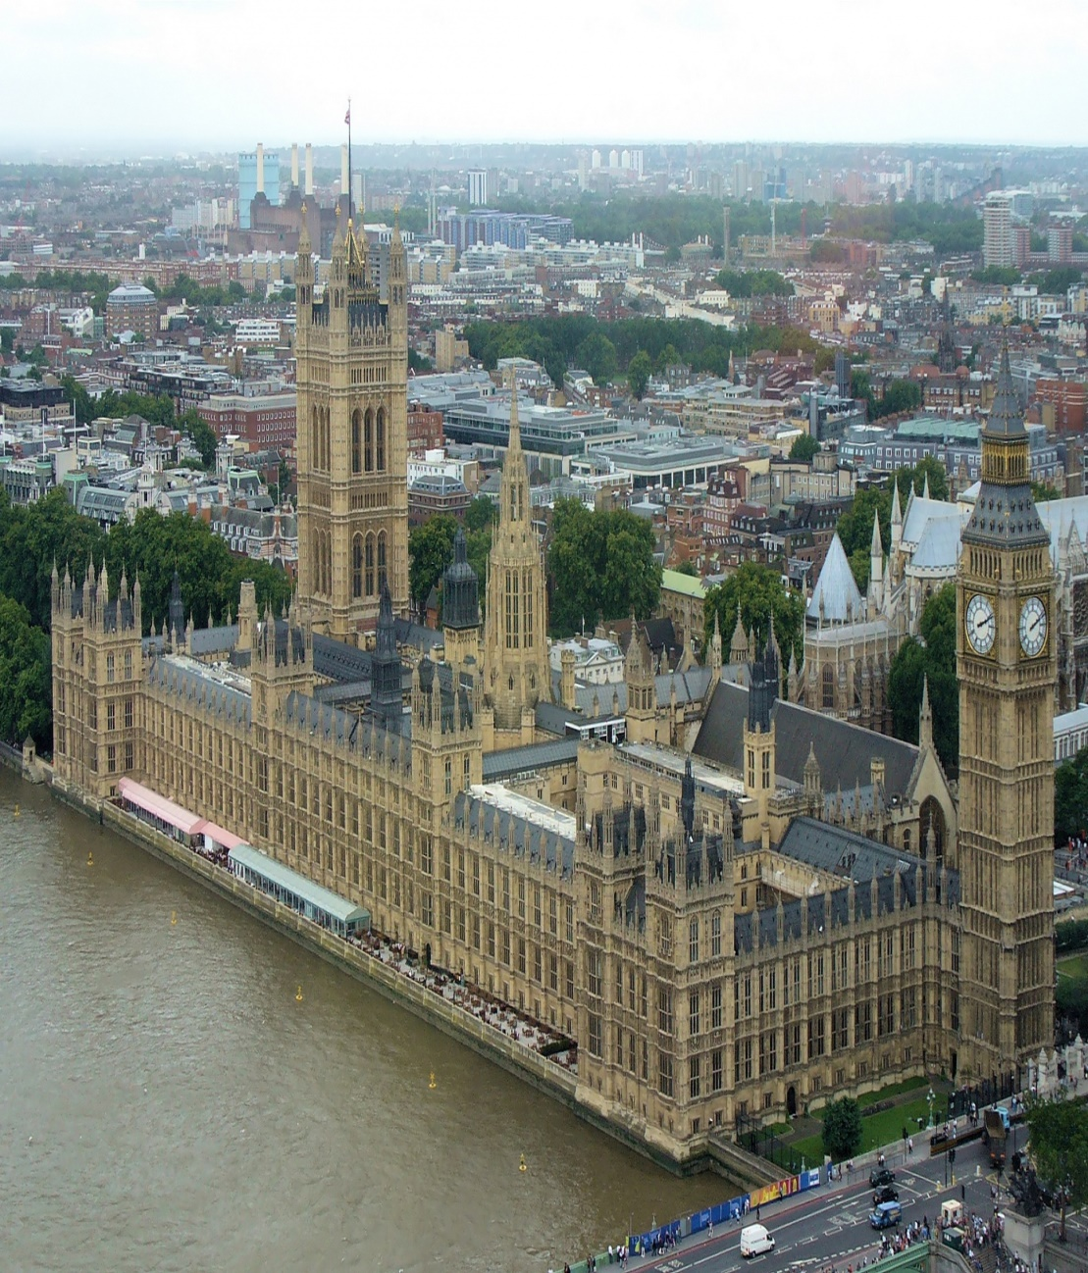
construction
The construction of Big Ben began in 1843 , after the great fire of London on October 16, 1834, which seriously affected the Palace of Westminster . Charles Barry was commissioned by the reconstruction project, which added the tower to the Palace and designed it in a Victorian Gothic style .

Slide 4
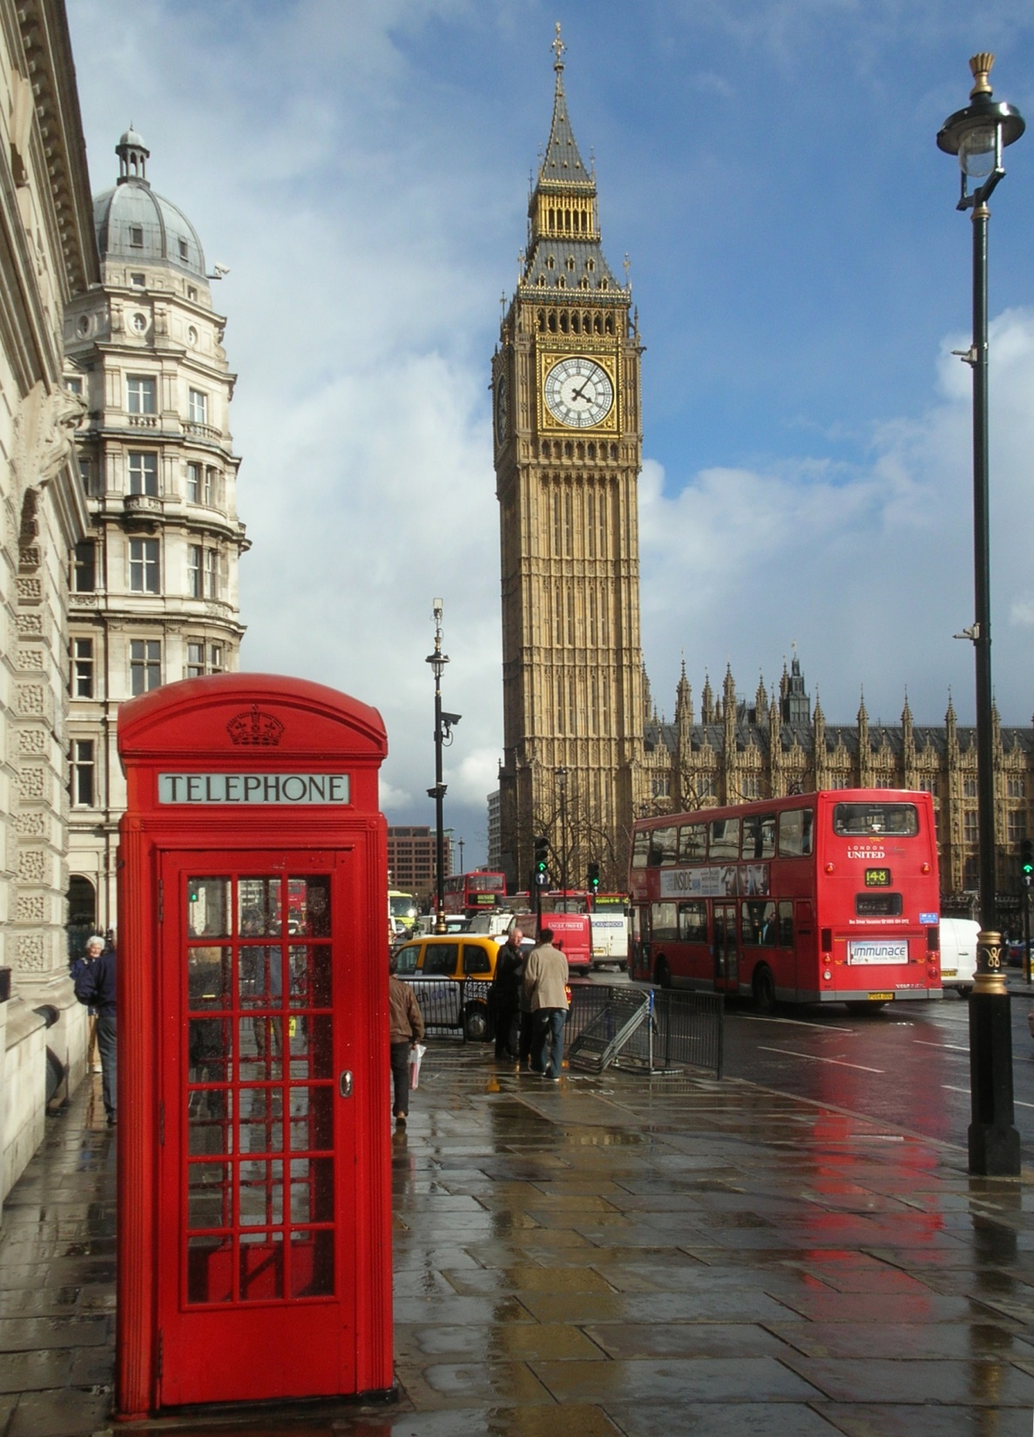
HEIGHT
HEIGH
This monument has a height of 96.3 meters and sits on a base of 225 square meters. Each Big Ben clock face measures 7.5 meters and the hands are of great length; the hour hand measures 2.7 meters long while the minute hand measures 4.3 meters. The numbers on the clock are not far behind with its 50 centimeters of height.

Slide 5
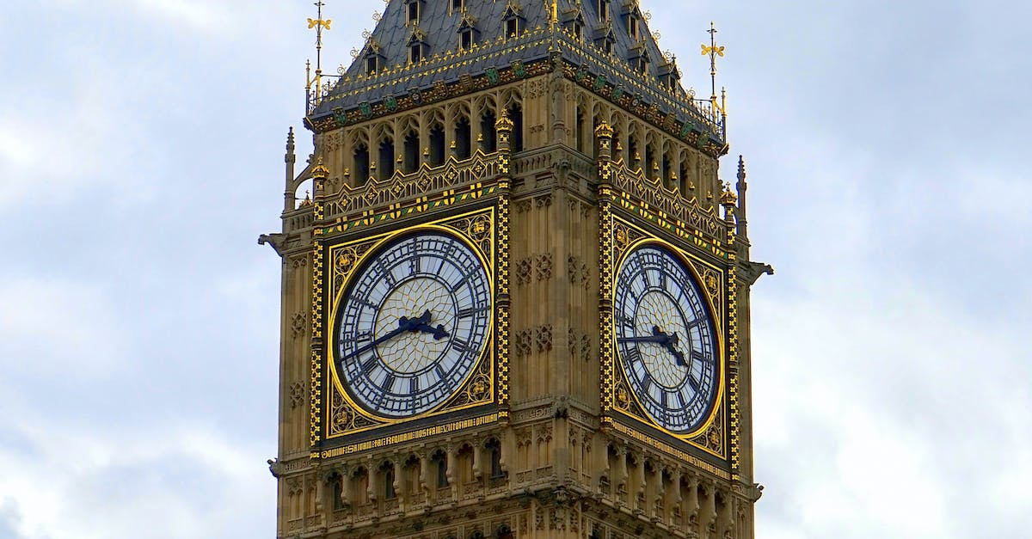
RELIABILITY
The watch is known for its reliability , as it has rarely stopped working. Even after the bombings that London suffered during World War II , the watch has not seen its punctual reputation altered one bit.

