Slide 1
THE BIG BEN
DRAFT
Constanza Quinn del Castillo
4°A
English Class
Prof. Víctor

Slide 2
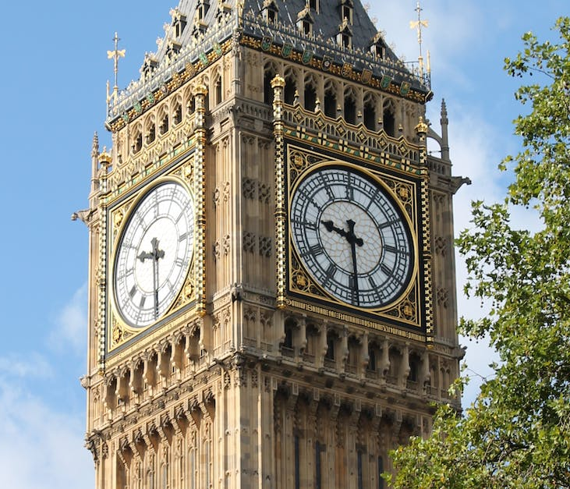
WHY THE famous clock IN ENGLAND is CALLED the BIG BEn?
According to history, the name BIG BEN derives from BIG (that in espanish is grande) due to its imposing size and ben in honor of benjamin hall, english secretary of labor who ordered the construction of the building.
WHERE IS THE BIG BEN?
BIG BEN tower clock is at the northern end of the houses of Parliament, in the London borough of Westminster

Slide 3
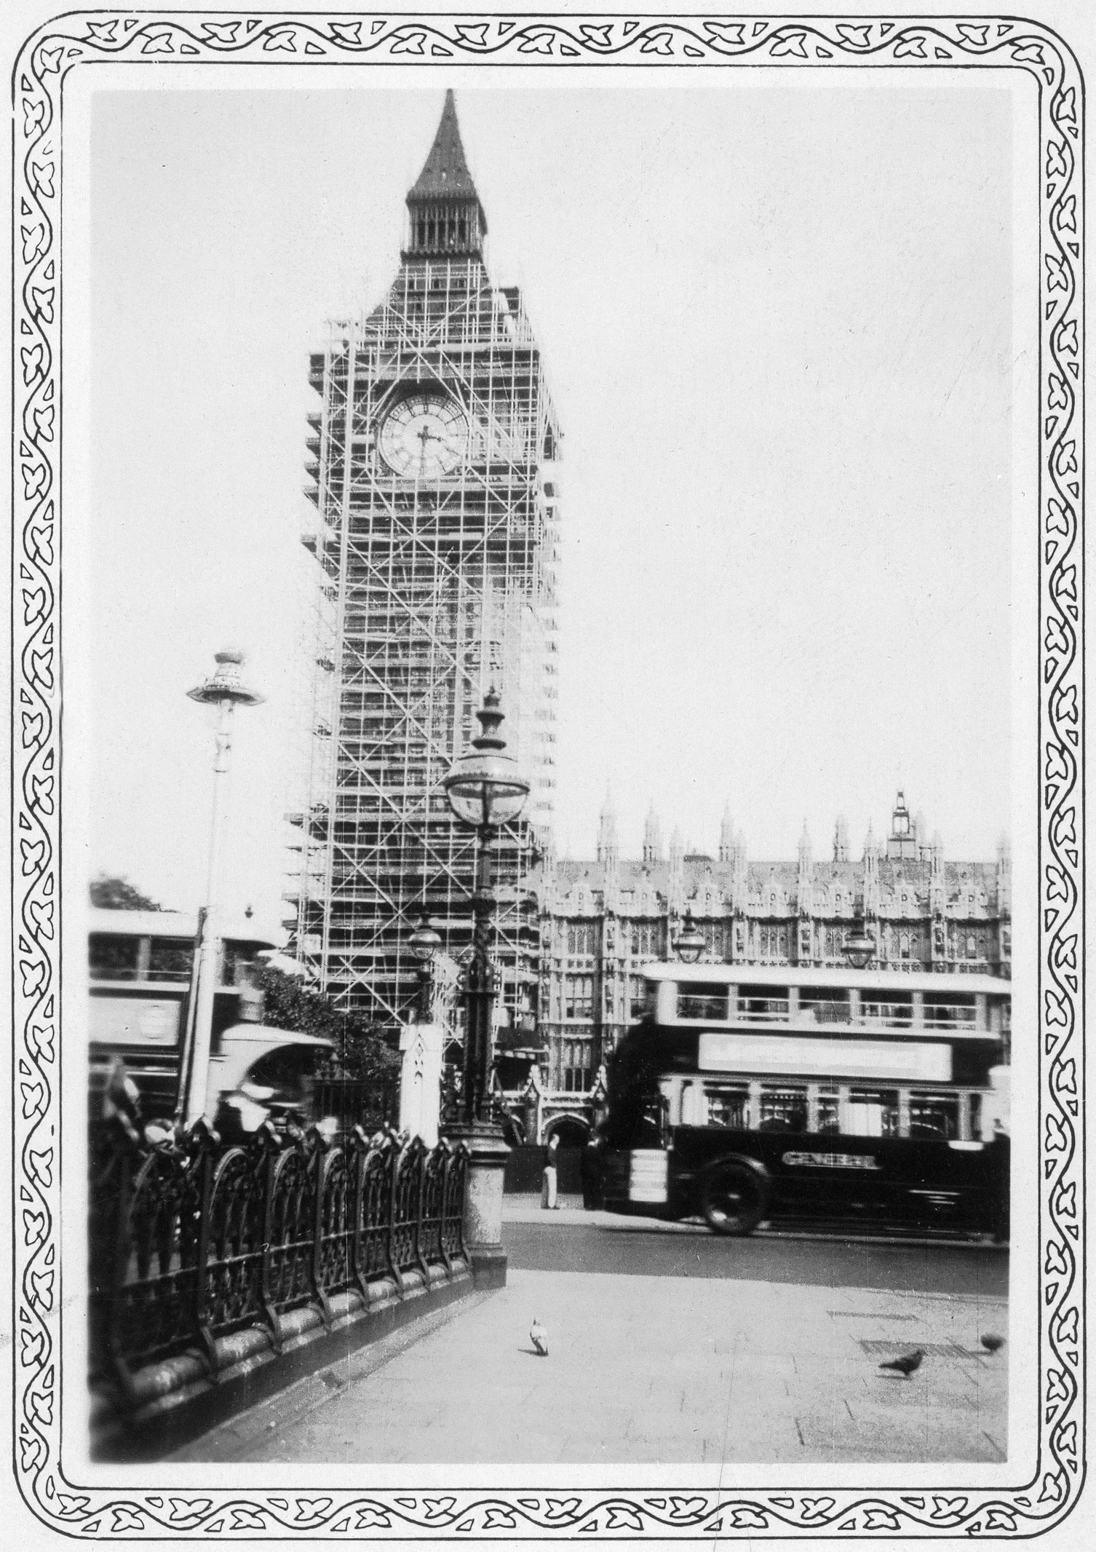
WHO BUILT BIG BEN?
BIG BEN began to be built as part of a new palace after the fire of October 16, 1884 in which Westminster¨s palace was destroyed. The famous Charles Barry was the chief architect of the project, but the desing was the work of Augustus Pugina.
HOW MANY YEARS DID THE BIG BEN TAKE TO BUILD?
BIG BEN began to be built in 1852 and finished in 1859, that is 7 years to be finished.
Esta foto de Autor desconocido está bajo licencia CC BY-SA
HOW TALL IS THE BIG BEN AND HOW LONG ARE THERE HANDS?
The BIG BEN is 97.5 meters tal and and his little hand measures 2.7 meters and the big one 4.3 meters.

