Slide 1
Buckingham palace
Mónica Sofía Guevara Zagal 4A

Slide 2
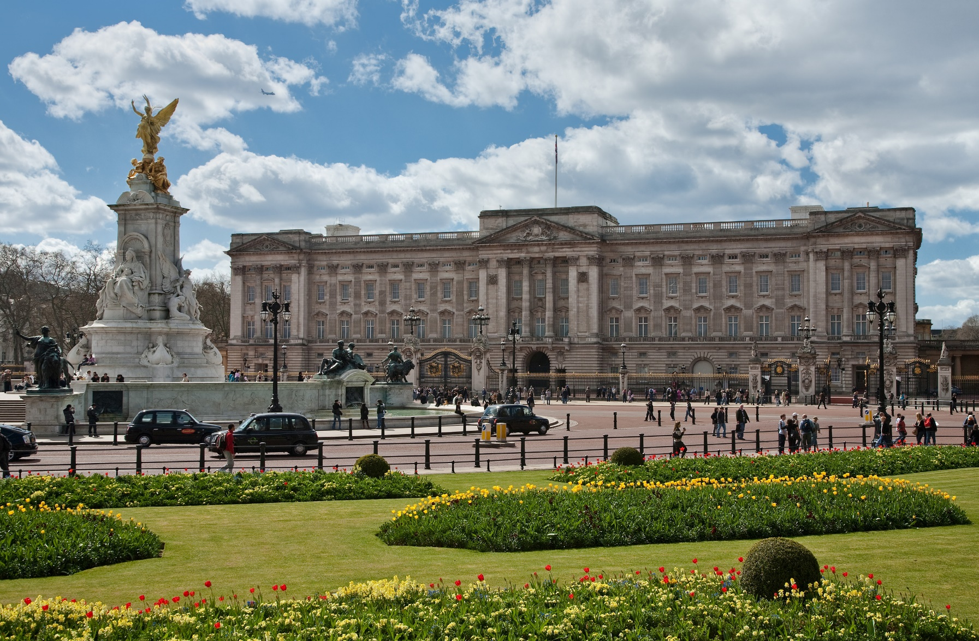
Buckingham palace is the official residence of the British family in London, it is also used for official ceremonias, state visits and tourists visits. It is famous for housing a substantial part of the Royal collection, an extraordinary set of artistic works resulting from royal collecting.

Slide 3
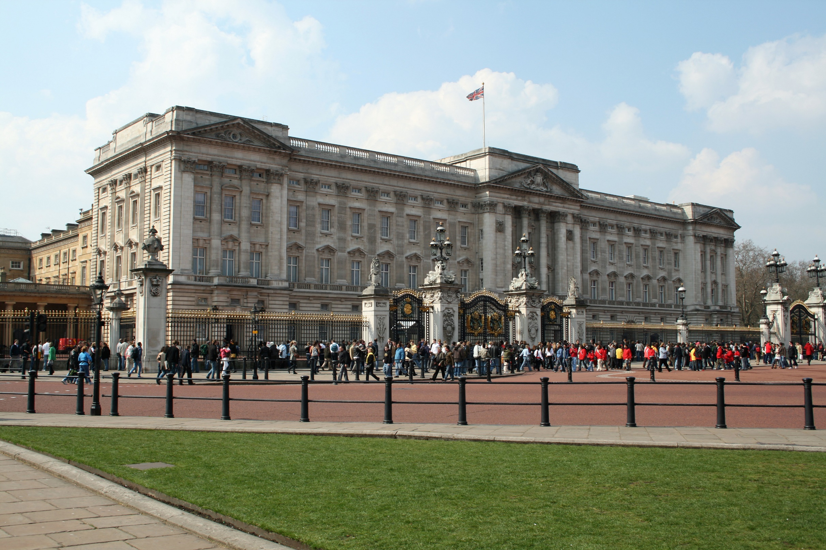
Who built it?
It was built for John Sheffield the 1st, Duke of Buckingham and Normanby in 1703 and acquired by King George lll in 1762 to become a public residence. Over the next 75 years it underwent a series of expansions directed by architects John Nash and Edward Blore (1850), creating three wings that make up an open central courtyard.

Slide 4
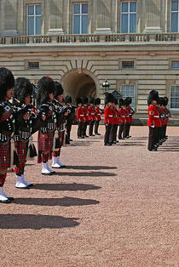
How long does the changing of the guard last in London?
45 minutes
The changing of the guard is one of the most important tourist attractions in London. It lasts approximately 45 minutes, in which the guards, crowned by enormous fur hats, carry out a parade to the rhythm of different musical themes, both military and other more of current styles.

