Slide 1
COLEGIO O´FARRILL
4º “A”
“Windsor Castle at England” student: Renata Dávila Cano

Slide 2
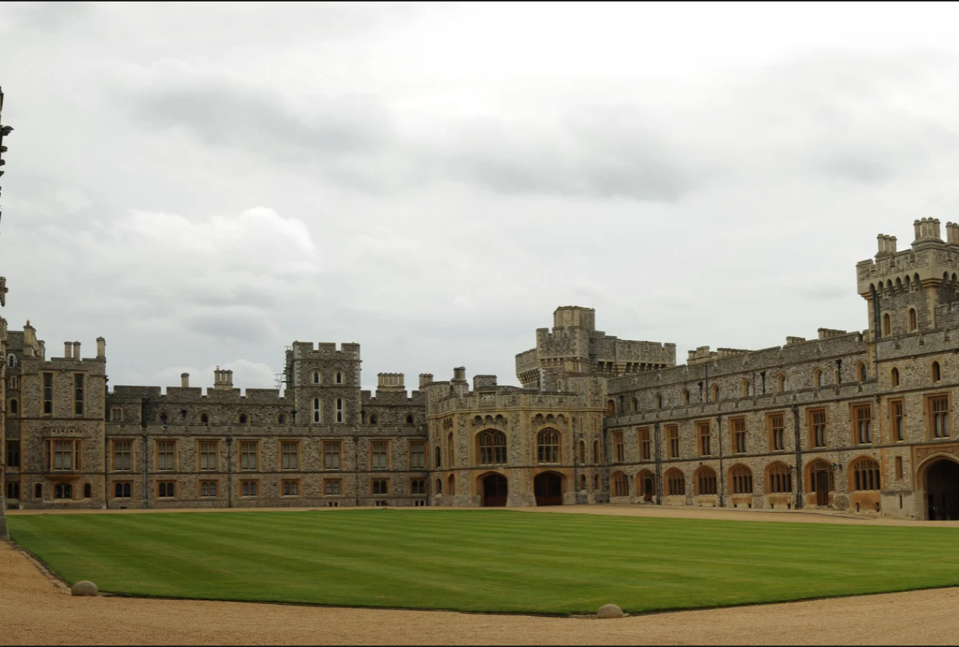
The Windsor Casttle
Was built in the XI (eleven) century. It means it was built
in 1070 year by “William the conqueror”
(in spanish is Guillermo el Conquistador)
Many kings of england lived there in the past.

Slide 3
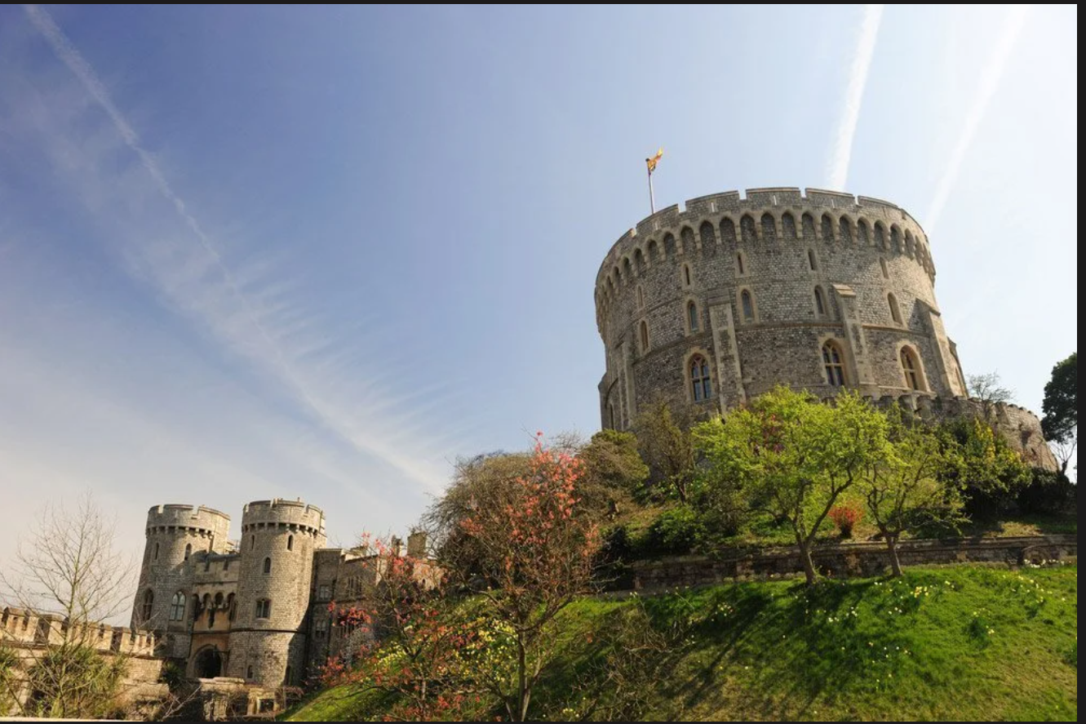
It is located in a place called Berkshire in the south of the United Kigndom.
There was a fire in the Casttle in 1992.

Slide 4
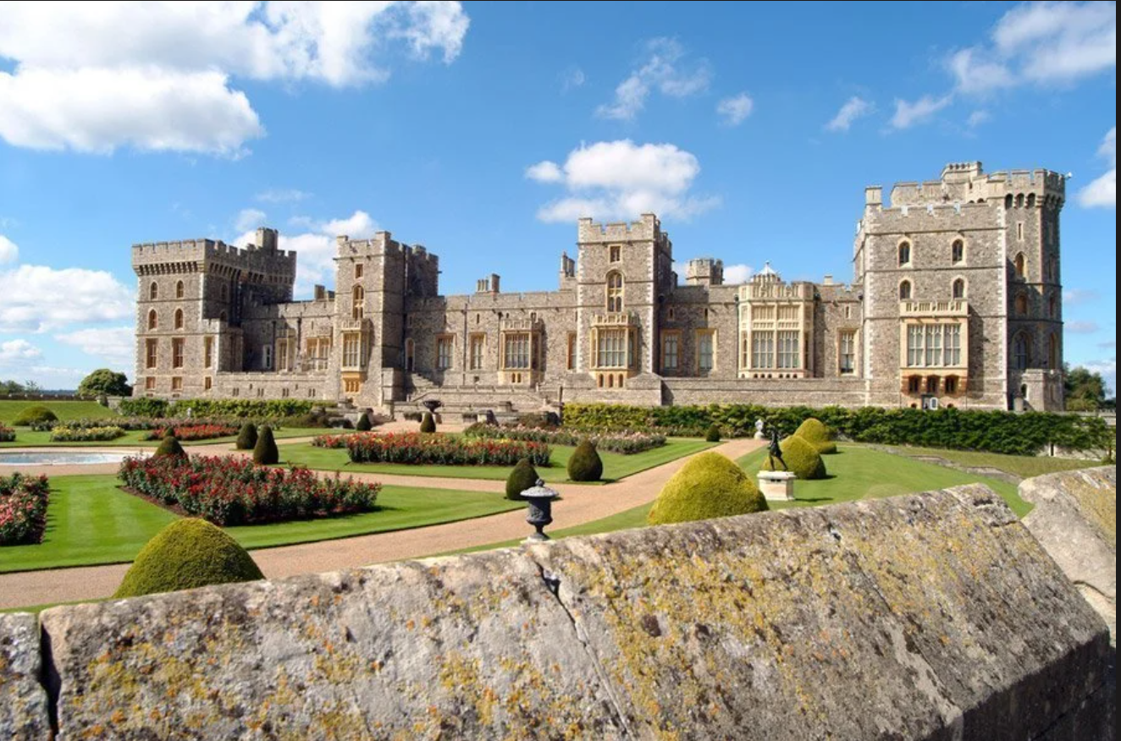
The queen Elizabeth II (the second) used it as a retire home and for
the weekends.

Slide 5
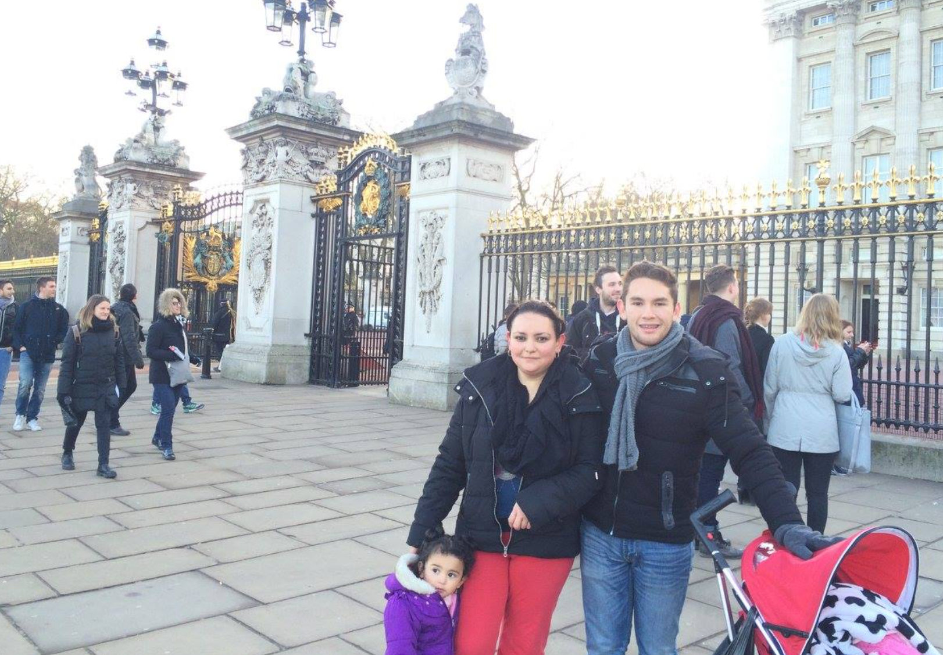
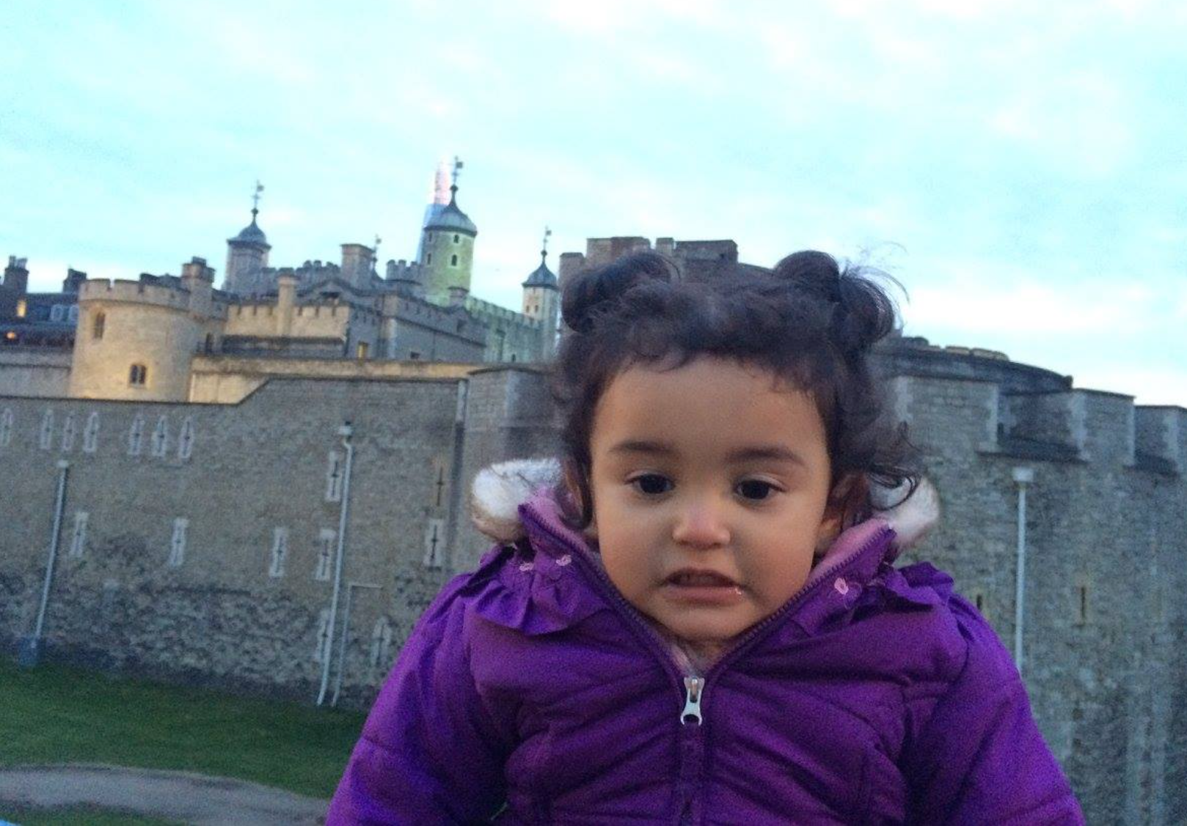
Ones I visited England, but I can´t remeber it beacuse I was just 2 years old.
For my good luck, my mom took pictures as memories!
I would love to go again and see the Windsor Casttle!
End…. Thank you!

