Slide 1

Buckingham Palace
Project
By Nicole Baeza Cano
4th Grade A
November 2023
Teacher Victor

Slide 2
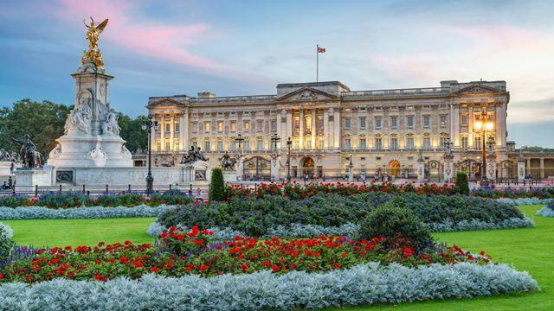
Buckingham Palace
Buckingham Palace is a grand royal residence with 775 magnificent rooms, highlights of the Summer Opening of Buckingham Palace include:
The 19 beautifully decorated Buckingham Palace State Rooms, used for receiving guests and official functions.
The Throne Room – often used as a backdrop for royal wedding photos.
The magnificent Grand Staircase.
Pieces of fine art, including works by Rembrandt, Rubens and Van Dyck.

Slide 3
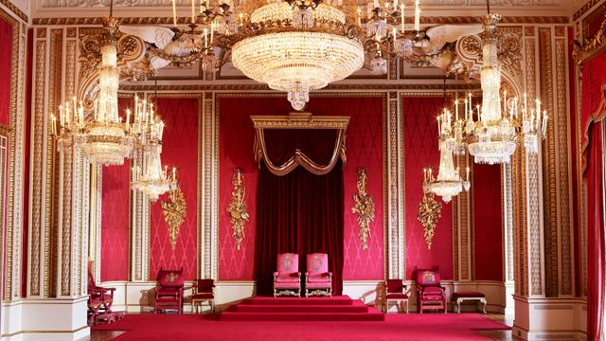
Buckingham Palace
Situated in the grand Ballroom, the display featured awe-inspiring clothing from the ceremony at Westminster Abbey. You could also see historic vestments worn by His Majesty at the moment of crowning including the Coronation Glove, Girdle (Sword Belt and Stole Royal. Along with the grand robe of estate, made from purple silk velvet and golden lace, worn by The King for his departure from the Abbey to Buckingham Palace to greet the crowds on the famous balcony.

Slide 4
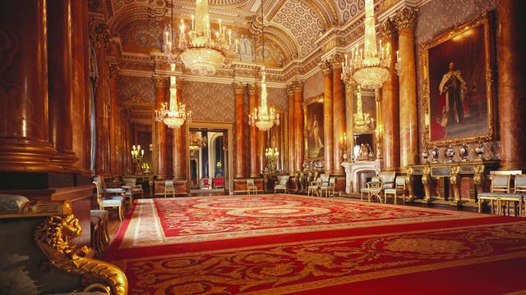
Buckingham Palace
How long does it take to tour Buckingham Palace?
It takes between two hours and 30 minutes to explore Buckingham Palace.
In 1703 the construction began for John Sheffield, who became the Duke of Buckingham and Normandy. Willian Winde, a renowed English architect,designed a large house with service wings for the Duke who reside there. In 1705, the construction was completed.

Slide 5
END

